Slide 1
Radiologic Technology
Today & Tomorrow
From Analogue to Digital

Slide 2
Digital image?

Slide 3
Analogue to digital conversion
Analogue Image
Digital representation
20
20
20
20
20
20
20
20
20
20
20
20
20
20
20
20
20
20
20
20
20
20
20
20
20
20
20
20
20
20
20
5
5
5
20
20
20
20
20
20
20
20
20
20
20
3
20
20
20
20
20
20
20
20
20
7
10
10
10
10
10
7
20
20
20
20
20
20
7
10
10
10
10
10
7
20
20
20
20
20
20
7
20
3
20
3
20
7
20
20
20
20
20
20
20
20
3
20
3
20
20
20
20
20
20
20
20
20
20
3
20
3
20
20
20
20
20
20
20
20
20
20
20
20
20
20
20
20
20
20
Any variation represented by Continuous change of shades of grey from white to black
The variation is divided into small areas called pixels and is represented by an abrupt change of numbers

Slide 4
Digital Image Display
DISPLAY
Digital representation
20
20
20
20
20
20
20
20
20
20
20
20
20
20
20
20
20
20
20
20
20
20
20
20
20
20
20
20
20
20
20
5
5
5
20
20
20
20
20
20
20
20
20
20
20
3
20
20
20
20
20
20
20
20
20
7
10
10
10
10
10
7
20
20
20
20
20
20
7
10
10
10
10
10
7
20
20
20
20
20
20
7
20
3
20
3
20
7
20
20
20
20
20
20
20
20
3
20
3
20
20
20
20
20
20
20
20
20
20
3
20
3
20
20
20
20
20
20
20
20
20
20
20
20
20
20
20
20
20
20
A range of pixel values are assigned a different grey level in increasing or decreasing order
The variation is divided into small areas called pixel and is represented by an abrupt change of numbers

Slide 5
History – evolution of Medical Imaging
Analogue images (from 1895)
Digital images (From 1970s)
General Radiography
X-RAY FILM Direct exposure radiography
Film Screen Radiography
Body section radiography (Tomography)
Fluoroscopy
Mammography
Contrast radiography
Conventional Angiography
Barium studies
Intravenous Urography
……………
Computerized Tomography (CT)
Magnetic resonance imaging (MRI)
Ultrasound scanning
Nuclear imaging
Conventional scans
SPECT
PET
PET-CT
SPECT-CT
Digital Radiography

Slide 6
Fuji introduced first digital radiography system known as Computed radiography (CR)
1980 s

Slide 7
Digital Radiography
Computed Radiography (CR)
Direct Digital Radiography (DDR)

Slide 8
Digital
Radiography
CR
Barium
Fluorohalide
Posphor
---------
photodiode
Scanned
Projection
Radiography
(SPR)
NaI
Scintilator
------------
Photodiode
Indirect
DR
CSI
Scintilator
-------
a-Si,Thin-film
transistor
Indirect
DR
CsI
-----
Charge
coupled
Device
Direct DR
a-Se
-------
Thin-film
transister

Slide 9
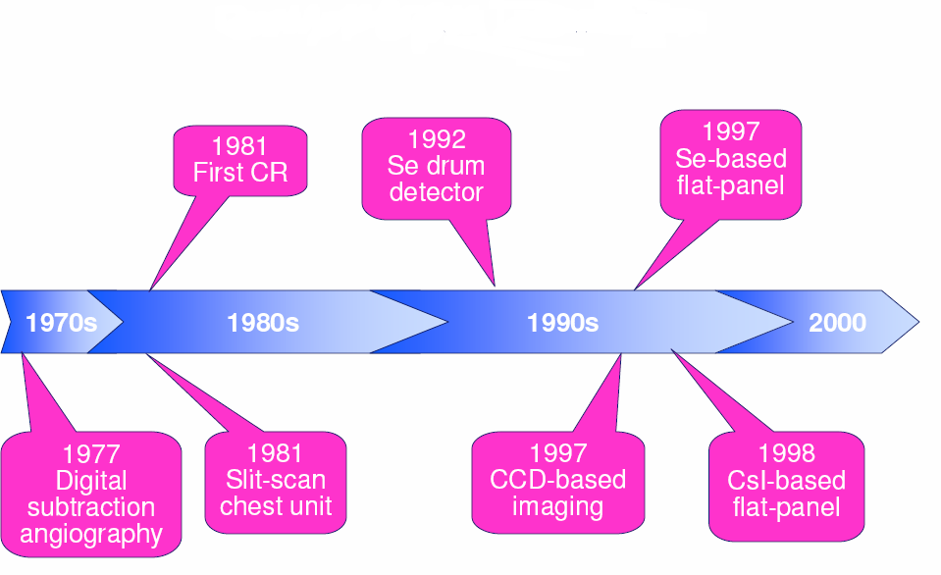

Slide 10
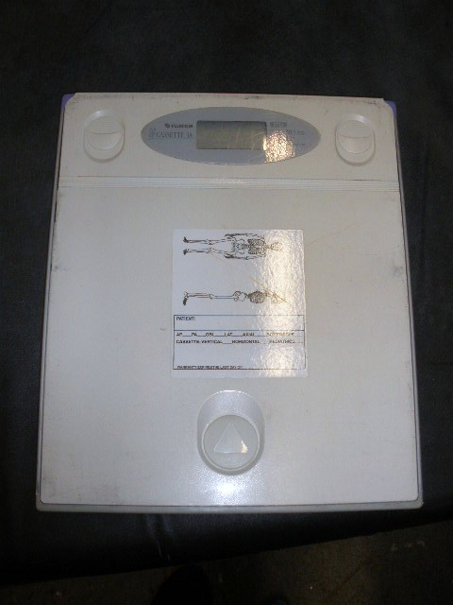
CR uses an Imaging Plate (IP)

Slide 11
CR steps
11

Slide 12
CR Reader
R abcd
R abcd
R abcd
Insert IP cassette here
R abcd
R abcd
It is a compact mechanico, optico, computer assemble.
Fuji CR reader

Slide 13
All –digital imaging provides following advantages over screen-film radiography
No chemical processing
Post Enhancement of the image information content
No filing and storage of hardcopies
Images can be viewed at several places at a time (networking)

Slide 14
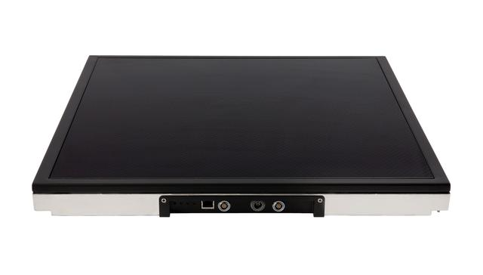
Flat panel detector for DDR
Available in portable form also

Slide 15
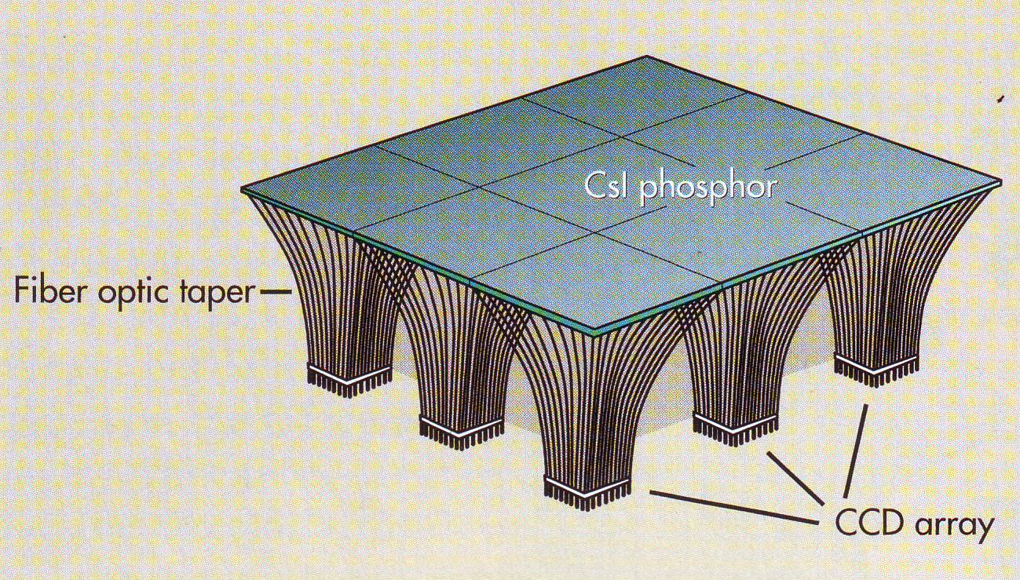
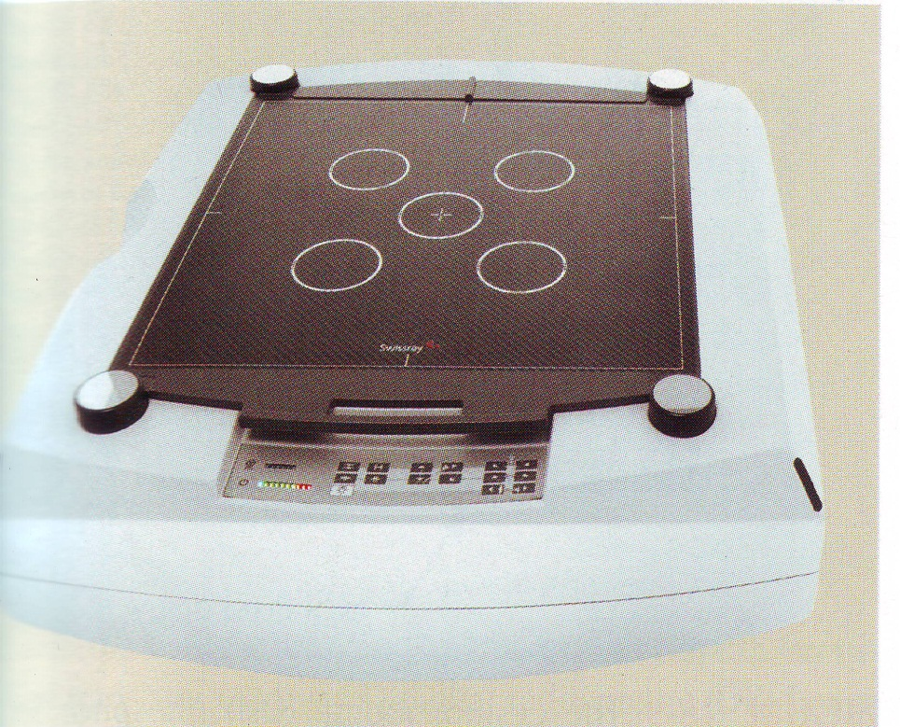
Indirect DR with CCD
CsI phosphor coupled with Tiled CCD
CCD detector for DR

Slide 16
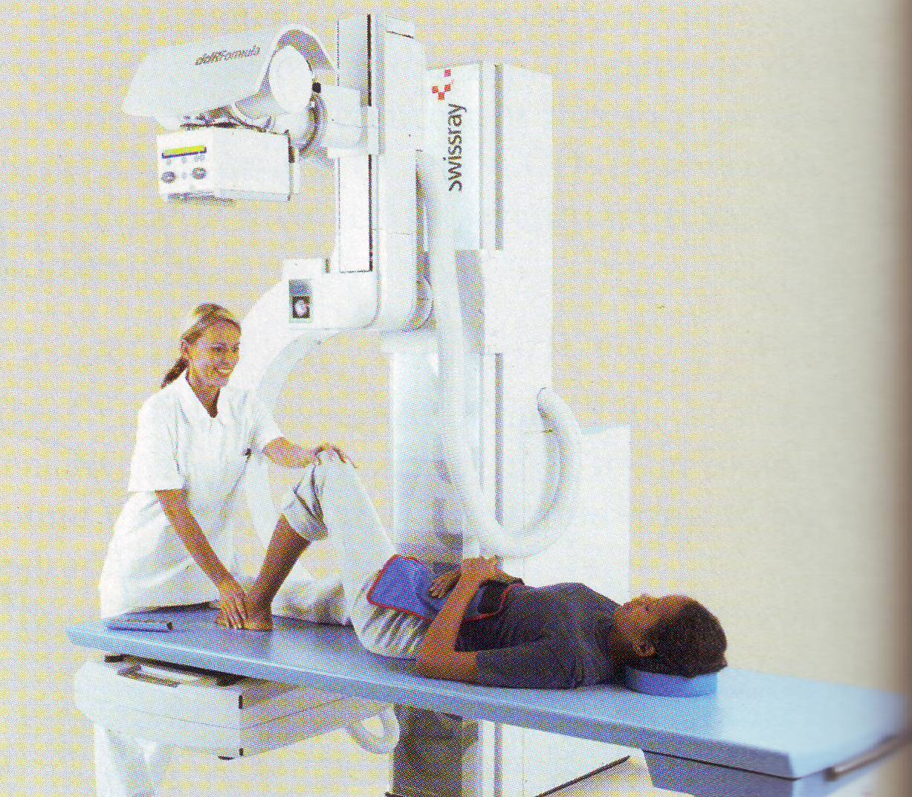
DR system with CCD

Slide 17
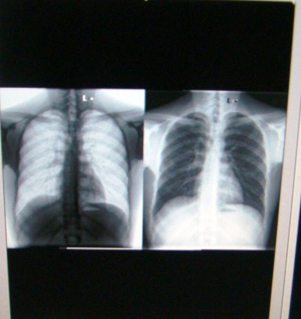
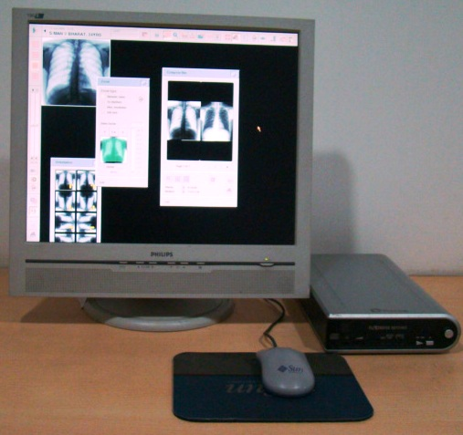
Manipulation of Images

Slide 18
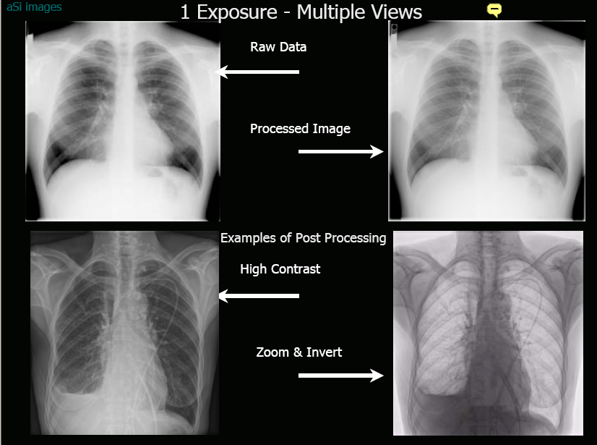
Manipulation of Images

Slide 19
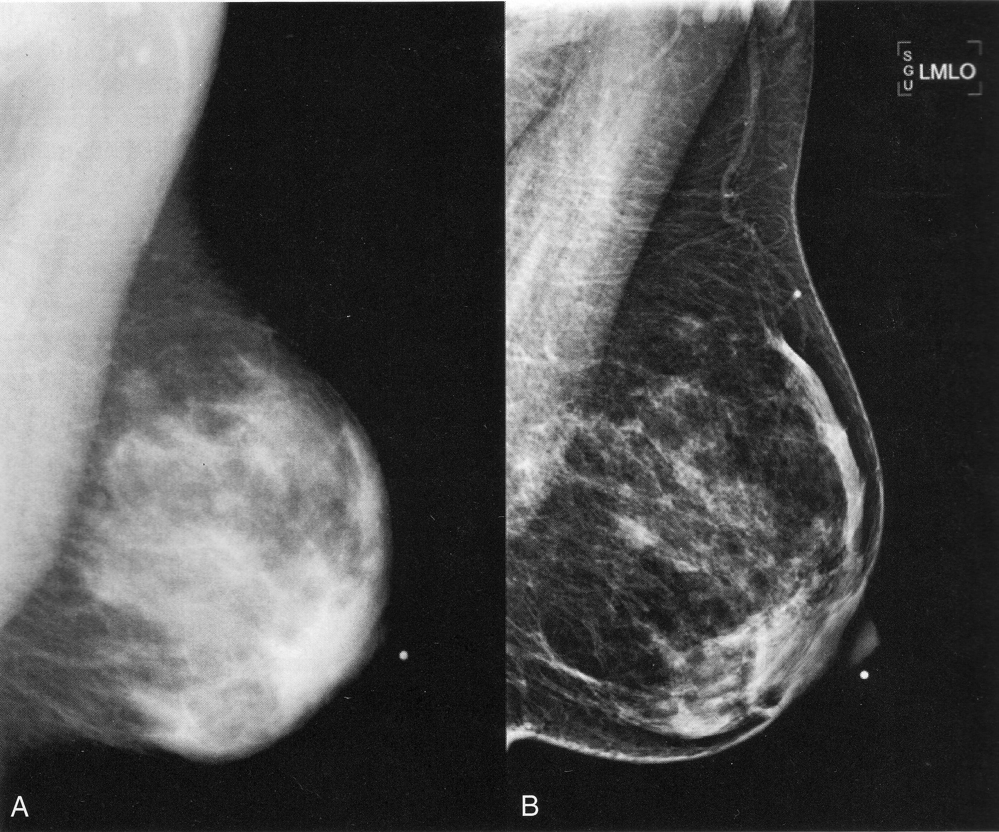
Conventional Mammography Vs DMT

Slide 20
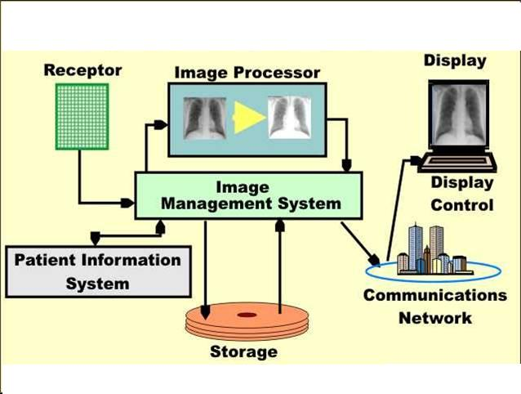
Digital Image Management System (DIMS)/PACS

Slide 21
System integration using DICOM
DICOM
MRI
CT
NM
US
CR
DR
Network
Digital Imaging & Communication in Medicine
DICOM – Digital Imaging & Communication In Medicine
Notes:
DICOM – Digital Imaging & Communication In Medicine

Slide 22
Advantage of Digital with PACS
Examination
scheduled
Patient
registered
Folder
prepared
Escort Pt. to
X-ray room
Repeat
Position
patient
Network
Escort
Pt. out
Load
cassette
Image
QC
To
Radiologist
Perform
examination
Films to
folder & file
Hang
films
Reload
cassette
Process
film

Slide 23
WHY turn to DIGITAL?
More than 60% of manpower of radiology department is involved in plain film radiology. Can be reduced
Digital imaging has potential to improve efficiency within radiology department.
Improved working, both intra & inter department.
Dose reduction is strongly associated with digital radiography.
Digitalization of radiograph (through CR/DR) acts as a medium for effective :
Data manipulation
Data transfer ( PACS, telemedicine)
Data storage (space saving)
If no hard copy is required great saving on films & chemicals
Fashionable, moving ahead with changing technologies.
Inevitable ? With telemedicine growing up .

Slide 24
Thank YOU!
V.G.Wimalasena
Principal
Sri Lanka school of Radiography
Website :- http://scrsl.weebly.com

