Slide 1
Flow Phenomena Compensation
even echo rephasing
gradient moment nulling
spatial pre - saturation
V.G.Wimalasena
Former Principal
Sri Lanka School of Radiography

Slide 2
Introduction
Flowing nuclei produce a very confusing range of signal intensities.
Ideally, these should be compensated for, in order to minimize their adverse effects on image quality and interpretation.
There are several methods to help minimize flow artefacts.
The methods for reducing flow phenomena are:
even echo rephasing
gradient moment nulling
spatial pre - saturation

Slide 3
Even echo rephasing
If two or more echoes are produced in a spin echo pulse sequence, intra - voxel dephasing may be reduced by acquiring the second and succeeding even echoes at a multiple of the first TE; for example, two echoes, first TE 40 ms and second TE 80 ms.
This works on the principle that flowing nuclei that are out of phase at the first echo are in phase at the second echo as long as the nuclei are given exactly the same amount of time to rephase as they were given to dephase.
In other words, if at the first TE of 40 ms they are out of phase, 40 ms later (at 80 ms) they will be in phase again. This is called even echo rephasing and can be used to reduce artefact in a T2 weighted image.

Slide 4
1. Gradient moment rephasing(nulling)
Gradient moment rephasing compensates for the altered phase values of nuclei flowing along a gradient.
It uses additional gradients to correct the altered phases back to their original values.
By doing that, flowing nuclei do not gain or loose phase due to the presence of the main gradient.
This is performed by using slice select gradient and/or readout gradient.

Slide 5
The gradient alters its polarity from positive to double negative and then back to positive again.
A flowing nucleus traveling along these gradients, experiences different magnetic field strengths.
In order to compensate altered phase values, the precessional frequency at the beginning of gradient moment rephasing must be the same as it is at the end.
The net precessional frequency and phase change must therefore be zero.

Slide 6
Gradient moment rephasing

Slide 7
Gradient moment rephasing
+4000 Hz
+8000 Hz
+12000 Hz
Frequency of a stationary nucleus along a normal gradient
0
0
+4000 Hz
+12000 Hz
0
Frequency of a stationary nucleus along the compensatory gradient
-16000 Hz
Phase of a flowing nucleus
Frequency of a flowing nucleus
0
+4000 Hz
-12000 Hz
0
0

Slide 8
Result of gradient movement rehasing
Gradient moment rephasing reduces intra-voxel dephasing.
As flowing nuclei have the same phase as stationary nuclei in the same voxel, their signals add constructively and therefore a brighr signal results.
Gradient momemt rephasing gives flowing nuclei a bright signal as spins are in phase.

Slide 9
Note
Gradient moment rephasing assumes a constant velocity across the gradients.
Most effective in slow laminar flow (1st order motion)
More effective in venous rather than arterial flow.
As it uses extra grdients minimum TE is increased
Fewer slices may be obtained for a given TR
As flowing nuclei are bright usually used for T2 or T2* weighted images where fluid (blood & CSF) is bright anyway.

Slide 10
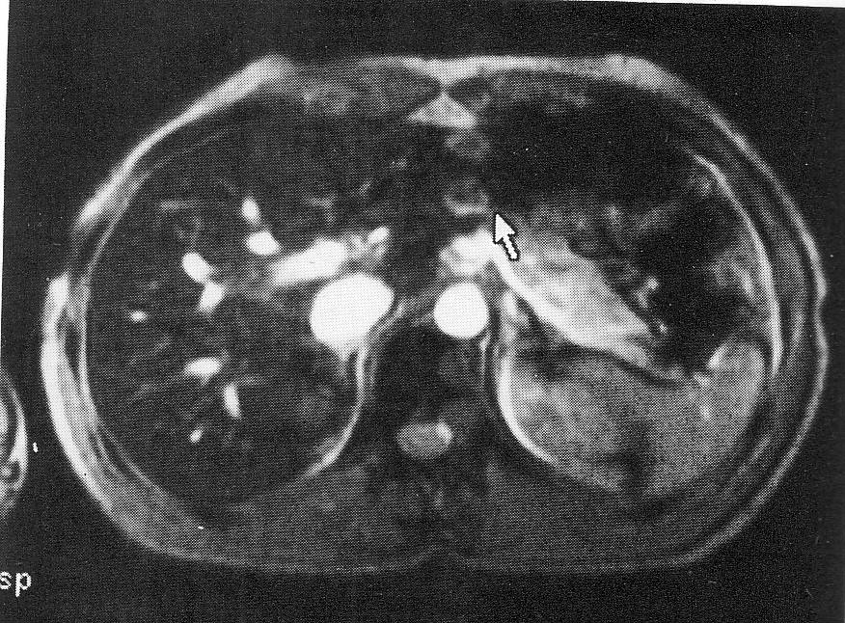
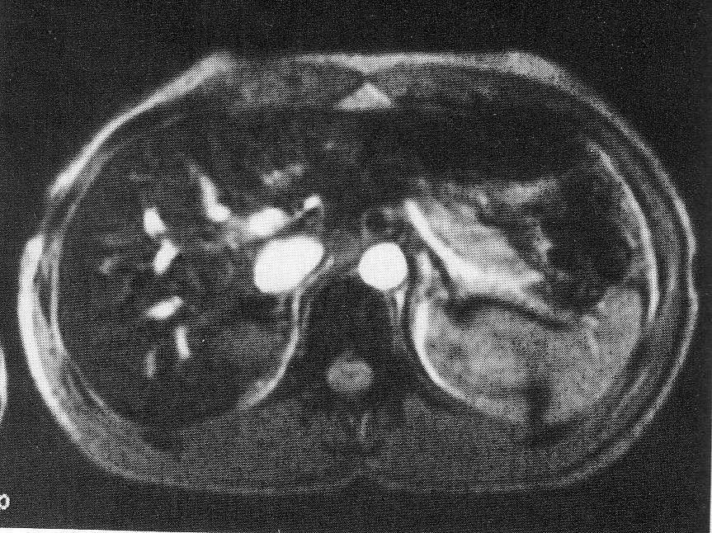
Example
Without GMR – shows mismapping of the flowing nuclei within the Aorta (arrow – ghost image of Aorta)
With GMR

Slide 11
Spatial Pre-saturation
Spatial Pre-saturation pulses are used to nullify the signal from flowing nuclei so that the effects of entry slice and TOF phenomena are minimized.
It delivers a 90⁰ RF pulse to a volume of tissue outside the FOV.
The flowing nuclei within the volume receives this pulse.
When they enter the slice stack, they receive the excitation pulse and become saturated.
If it is fully saturated to 180⁰, it has no transverse component of magnetization and produce a signal void.

Slide 12
Flowing nuclei
Saturation volume
vessel
Pre-saturation RF pulse
FOV
Excitation pulse
Stationay nuclei
Stationay nuclei
B₀

Slide 13
Spatial pre-saturation

Slide 14
Spatial pre - saturation pulses can be brought into the FOV itself.
This permits artefact - producing areas (such as the aorta) to be pre - saturated so that phase mismapping can be reduced.
Pre - saturation pulses are only useful if they are applied to tissue.
If they are applied to air they are not effective.
They increase the amount of RF that is delivered to the patient, which may increase heating effects.
The use of pre - saturation pulses may also decrease the number of slices available and should therefore be used appropriately.

Slide 15
Pre - saturation pulses are also only effective if the fl owing nucleus receives the 90 ° pre - saturation pulse.
Pulses are applied around each slice just before the excitation pulse.
The TR and the number of slices therefore govern the interval between the delivery of each pre - saturation pulse.
To optimize pre - saturation, use all the slices permitted for a given TR.
As pre - saturation produces a signal void, it is usually used in T1 and proton density weighted images where fluid (blood and CSF) is dark anyway.
Figures below show axial gradient echo images of the abdomen with and without pre - saturation.
Ghosting of the aorta seen on Figure left is largely eliminated by using spatial pre - saturation pulses in Figure right . Note also that the signal intensity of the aorta is reduced by using pre - saturation.

Slide 16
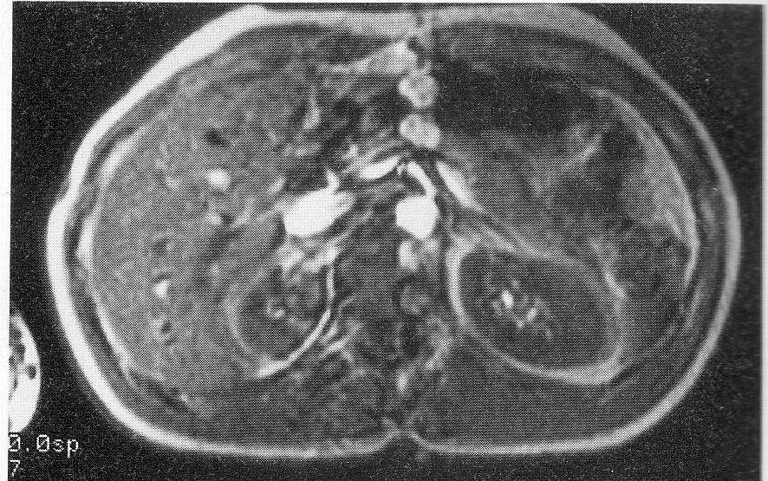
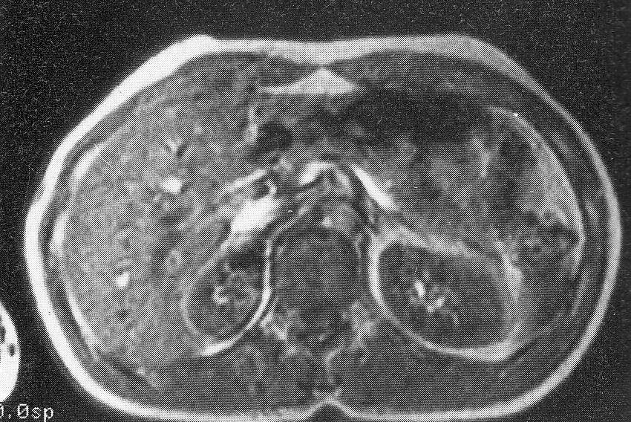
Example -pre-sturated images
Ghost Artefact from flowing nuclei within aorta (without saturation)
With pre-saturation
(T1) ? T2* weighted images

Slide 17
Other uses of pre-saturation
Pre-saturation nullifies signal and can therefore be used to specifically eliminate certain signals.
The main uses of this are:
chemical pre - saturation
spatial inversion recovery (SPIR).

Slide 18
1. Chemical (Fat & water) Pre saturation
Hydrogen exists in different chemical environments in the body, mainly fat and water.
The precessional frequency of fat is slightly different from that of water.
As the main magnetic field strength increases, this frequency difference also increases.
For example at 1.5 T the precessional frequency between fat and water is approximately 220 Hz, so fat precesses 220 Hz lower than water.
At 1.0 T this frequency difference is reduced to 147 Hz.

Slide 19
The frequency difference between fat and water is called chemical shift and can be used to specifically null the signal from either fat or water.
This technique is important to differentiate pathology (which is mainly water) and normal tissue (which often contains fat).
To saturate or null either fat or water, the precessional difference between the two must be sufficiently large so that they can be isolated from each other.
Fat or water saturation is therefore most effectively achieved on high field systems.

Slide 20
Fat saturation
To saturate fat signal, a 90 ° pre - saturation pulse must be applied at the precessional frequency of fat to the whole FOV.
The excitation RF pulse is then applied to the slices and the magnetic moments of the fat nuclei are flipped into saturation.
If they are flipped to 180 °, they do not have a component of transverse magnetizati on and produce a signal void.
The water nuclei, however, are excited, rephased and produce a signal..

Slide 21
Fat saturation

Slide 22
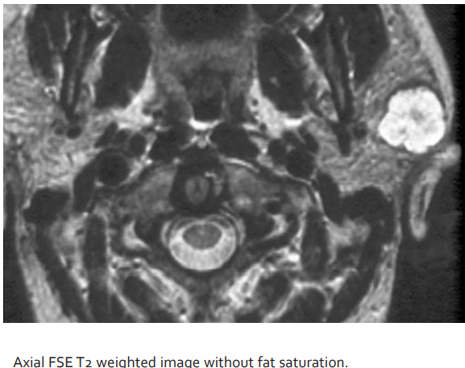
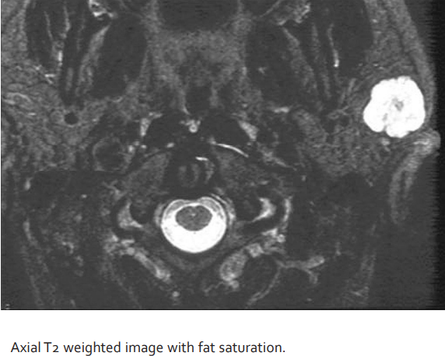
Fat saturation example
Figures compare axial T2 weighted images of the parotid gland, with and without fat pre - saturation. Using fat saturation has increased the CNR between the lesion and normal tissue as fatty components in the base of the skull have been nulled

Slide 23
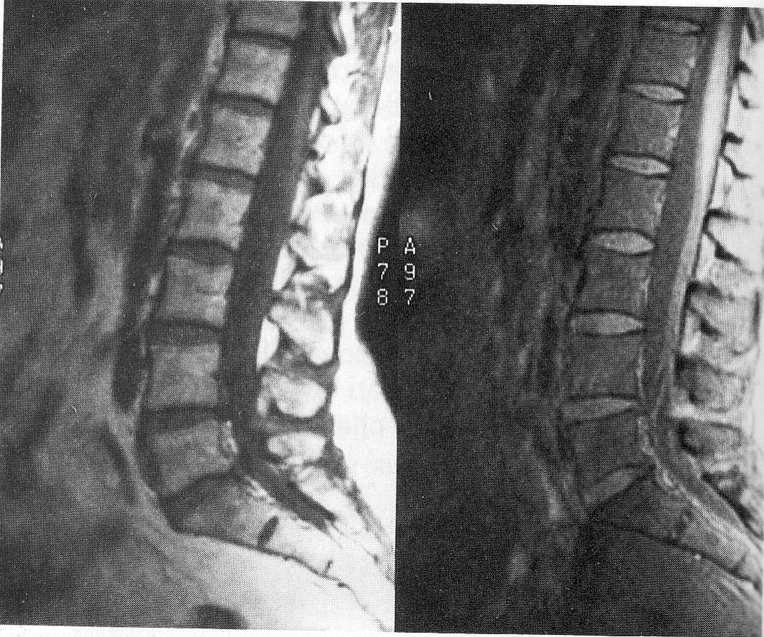
Fat saturation Example
Sagital T1 weighted images
Without fat saturation With fat saturation

Slide 24
Water Saturation
To saturate water signal the pre - saturation pulse must be applied at the precessional frequency of water to the whole FOV.
The RF excitation pulse is then applied to the slices, and the magnetic moments of nuclei in water are flipped into saturation.
If they are flipped to 180 ° they do not have a transverse component of magnetization and produce a signal void.
The fat nuclei, however, are excited, rephased and produce a signal. Figures 6.21 and 6.22 compare axial T1 weighted images of the liver, with and without water pre - saturation. Any fatty lesions in the liver are better demonstrated after water saturation as normal liver signal is nulled.

Slide 25
To be used eff ecti vely, there should be an even distributi on of fat or water throughout the FOV. Pre - saturati on RF is transmitt ed at the same frequency and evenly to the whole FOV, so that a parti cularly dense area of fat receives the same pre - saturati on energy as an area with very litt le fat. Under these circumstances fat saturati on is less eff ecti ve. In additi on, the gradients applied for spati al encoding vary the frequency across each slice. For this reason chemical pre - saturati on oft en appears non - uniform across the slice or imaging volume. Therefore opti mal saturati on occurs at the center of a slice or in the central porti on of the imaging volume. Fat and water pre - saturati on delivers extra RF into the pati ent and therefore reduces the number of slices available for a given TR.

Slide 26
The pre - saturati on pulses are delivered to the FOV before the excitati on of each slice. The interval between the pre - saturati on pulses is called the SAT TR and is equal to the scan TR divided by the number of slices. If the SAT TR is longer than the T1 ti mes of fat or water, the magneti c moments of fat or water may not be saturated as they have had ti me to recover before each pre - saturati on pulse is delivered. To prevent this, always prescribe the maximum number of slices available for a given TR so that the SAT TR is reduced to a minimum. Any ti ssue can be nulled in this way as long as an RF pulse matching its precessional frequency is applied to the imaging volume before excitati on. For example, silicone may be saturated to null its signal in breast imaging. This is a useful technique for ruptured implants. Spati al pre - saturati on is also useful to reduce artefacts such as phase mismapping and aliasing

Slide 27
Fat & water saturation pulses
Water saturation
Fat saturation
Saturation pulse
Water peak
Fat peak
Saturation pulse
220Hz
220Hz

Slide 28
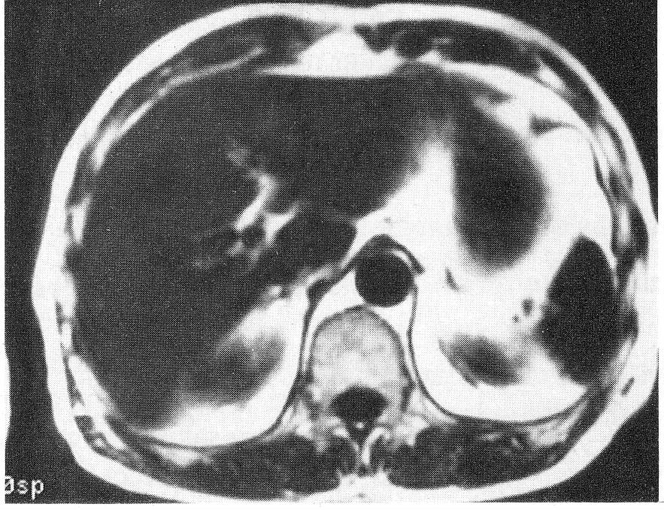
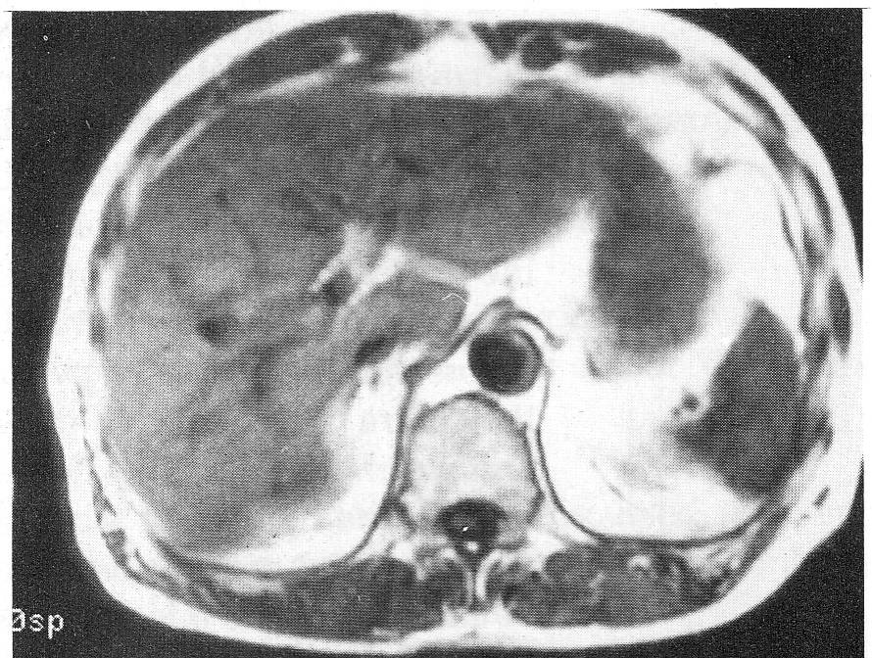
T1 weithed image without water saturation
T1 weigted image with water saturation

Slide 29
2. Spatial i nversion r ecovery ( SPIR )
In this technique an RF pulse at the precessional frequency of fat is applied to the imaging volume, but unlike chemical pre - saturati on this has a magnitude of 180 ° . The magneti c moments of fat are therefore totally inverted into the – Z directi on. Aft er a ti me TI, which corresponds to the null point of fat, the 90 ° excitati on pulse is applied. As fat has no longitudinal magneti zati on at this point, the excitati on pulse produces no transverse magneti zati on in fat. Therefore the fat signal is nulled (Figures 6.23 and 6.24 ).

Slide 30
This technique therefore combines fat saturati on and inverti ng mechanisms similar to STIR ( see Chapter 5 ) to eliminate fat signal. However, it has several advantages over both of these techniques. Chemical saturati on is very dependent on homogeneity of the main magneti c fi eld as it requires the precessional frequency of fat to be the same over the whole imaging volume. SPIR is much less suscepti ble to this because nulling also occurs by selecti ng an inversion ti me corresponding to the null point of fat. This depends on the T1 recovery ti me of fat rather than its precessional frequency and relaxati on ti mes are not aff ected by small changes in homogeneity. However, as STIR sequences totally rely on the T1 recovery ti mes to null signal rather than precessional frequencies, they are less likely to be aff ected by inhomogeneity than fat saturated methods such as SPIR or fat saturati on.

Slide 31
Figures 6.25 and 6.26 compare a STIR image with a SPIR image and clearly show more uniform nulling of fat in the STIR sequence. However, in STIR sequences, gadolinium may be nulled along with fat, as gadolinium shortens the T1 recovery ti me of ti ssues taking up contrast to that of fat ( see Chapter 11 ). Therefore STIR sequences must never be used aft er giving gadolinium. However, in SPIR sequences this does not occur because fat is selecti vely inverted and nulled, leaving gadolinium untouched. Therefore SPIR may be used to null the signal from fat in sequences where gadolinium has been given.

Slide 32
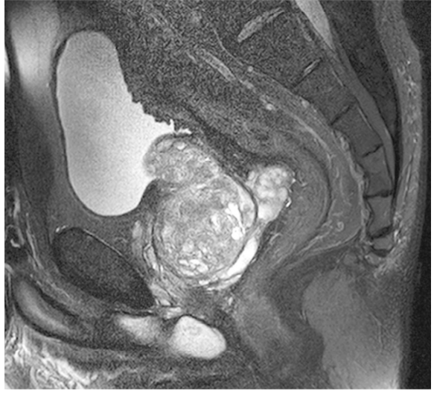
Sagittal T2 weighted FSE image of the pelvis Sagittal T2 weighted FSE image of the pelvis Sagittal T2 weighted FSE image of the pelvis with SPIR. Fat has been suppressed.

Slide 33
Summary
1. Gradient Moment Rephasing:
Uses additional gradients to correct altered phase values
Reduces artefact from intra-voxel dephasing
Gives flowing nuclei a bright signal
Is mainly used in T2 or T2* weighted images
Is most effective on slow, laminar flow within the slice

Slide 34
Summary
2. Pre-saturation:
Uses additional RF pulses to nullify signal from flowing nuclei
Reduces artefacts due to time of flight and entry slice phnomenon
Gives flowing nuclei a signal void
Is mainly used in T1 weighted images
Is effective on fast and slow flow
Increases the RF deposition to the patient
Can be used to nullify signal from fat or water and to reduce aliasing.

Slide 35
END

