Slide 1
Pulse sequences
Spin echo pulse sequences
Conventional spin echo
Fast or turbo spin echo
Inversion recovery
V.G.Wimalasena
Principal
Sri Lanka school of radiography

Slide 2
Introduction
There are number of different pulse sequences practically in use
Pulse sequences enable to control the way the system applies pulses and gradients
Each is designed for a specific purpose
Manufacturers uses different acronyms to distinguish between individual pulse sequences, which can be very confusing to the user. (next slide)

Slide 3
A comparison of acronyms used by manufacturers

Slide 4
Expansion of abbreviations

Slide 5
Pulse sequence?
The definition of a pulse sequence is a series of RF pulses, gradient applications and intervening time periods.
The RF pulses are applied for excitation purposes and, in the case of spin echo, for rephasing purposes.
The gradients are applied to spatially encode signal and to rephase and dephase spins depending on the type of pulse sequence and imaging option selected.
The intervening time periods refer to the time intervals between these various functions, some of which are extrinsic contrast parameters that are selected at the console.
Therefore a pulse sequence is a carefully co-ordinated and timed sequence of events to generate a particular type of image contrast

Slide 6
Categorization of pulse sequences
Spin echo pulse sequences (spins are rephased by a 180 ° rephasing pulse)
conventional spin echo
fast or turbo spin echo
inversion recovery.
Gradient echo pulse sequences (spins are rephased by a gradient)
coherent gradient echo
incoherent gradient echo
steady state free precession
balanced gradient echo
fast gradient echo
echo planar imaging

Slide 7
Conventional spin echo
Uses a 90⁰ excitation pulse followed by one or more 180⁰ rephasing pulses to generate a spin echo.
If only one echo is generated , a T1 weighted image can be obtained using a short TE and a short TR
For proton density and T2 weighting, two RF rephasing pulses, generating two spin echoes are applied.
The first echo has a short TE and a long TR to achieve proton density weighting
The second echo has a long TE and Long TR to achieve T2 weighting.

Slide 8
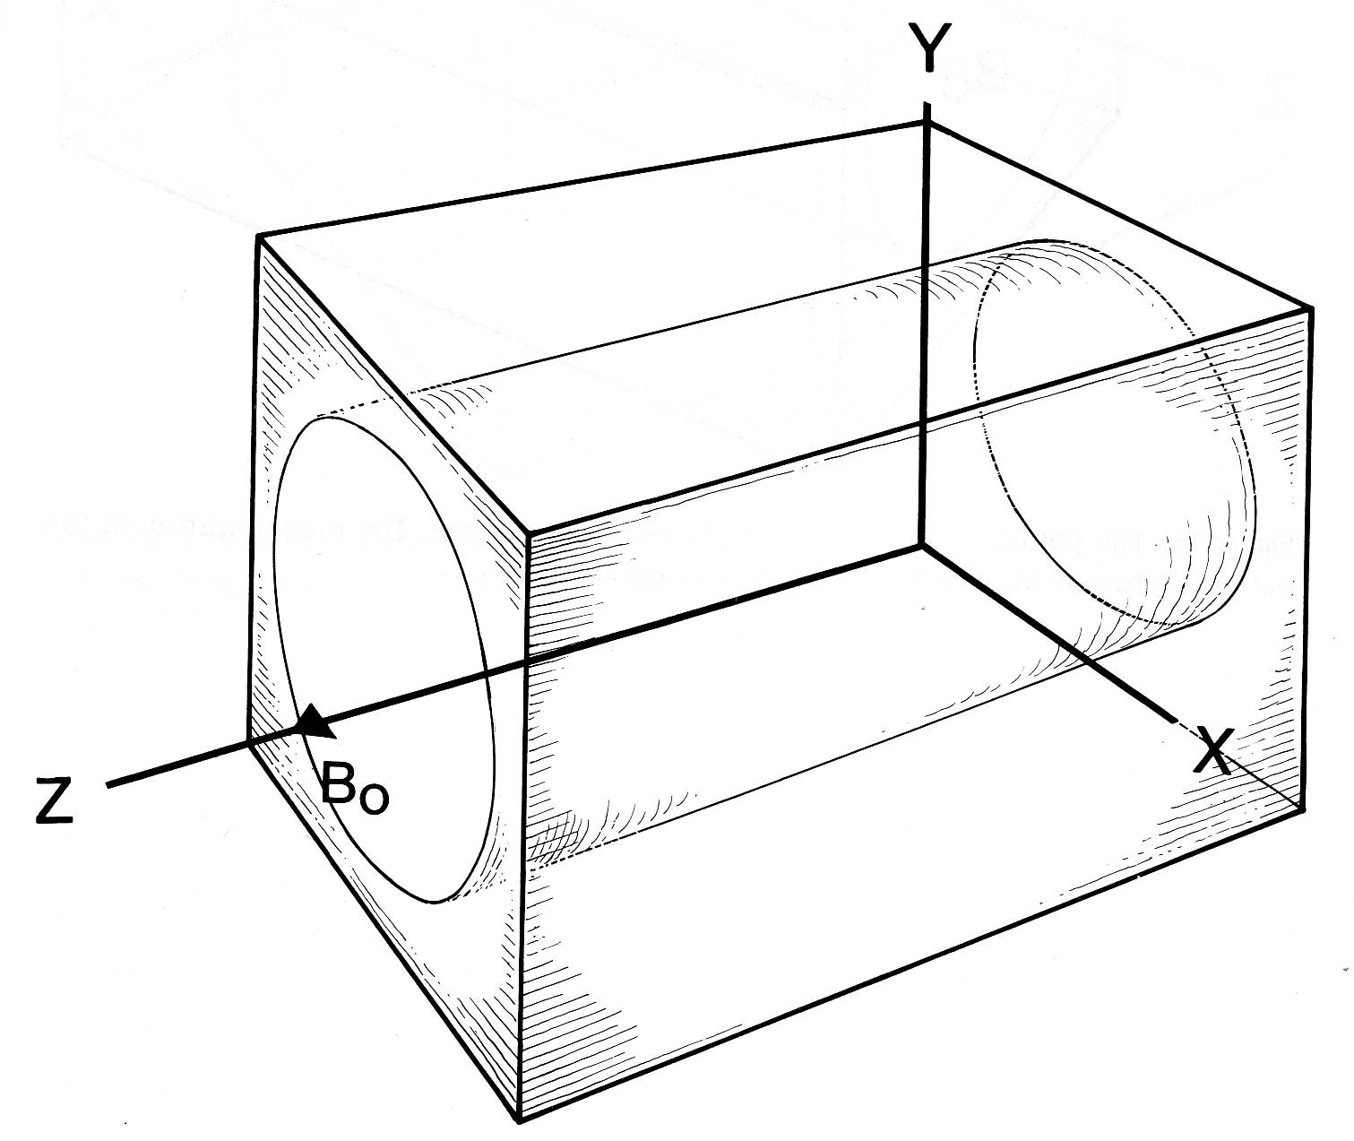
Conventional spin echo
We learned the principe in a previous lesson. For recap it is explained in the following Illustrations.
The situation before the patient is placed inside the magnet

Slide 9
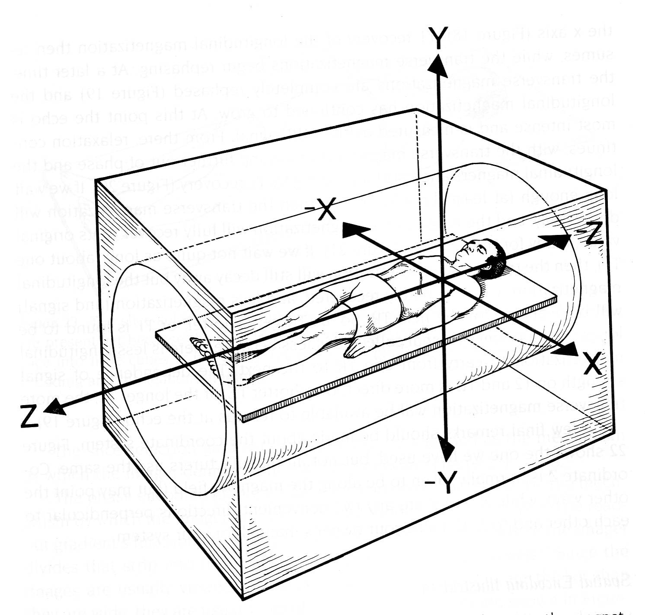
The coordinate system in relation to the magnet and the patient

Slide 10
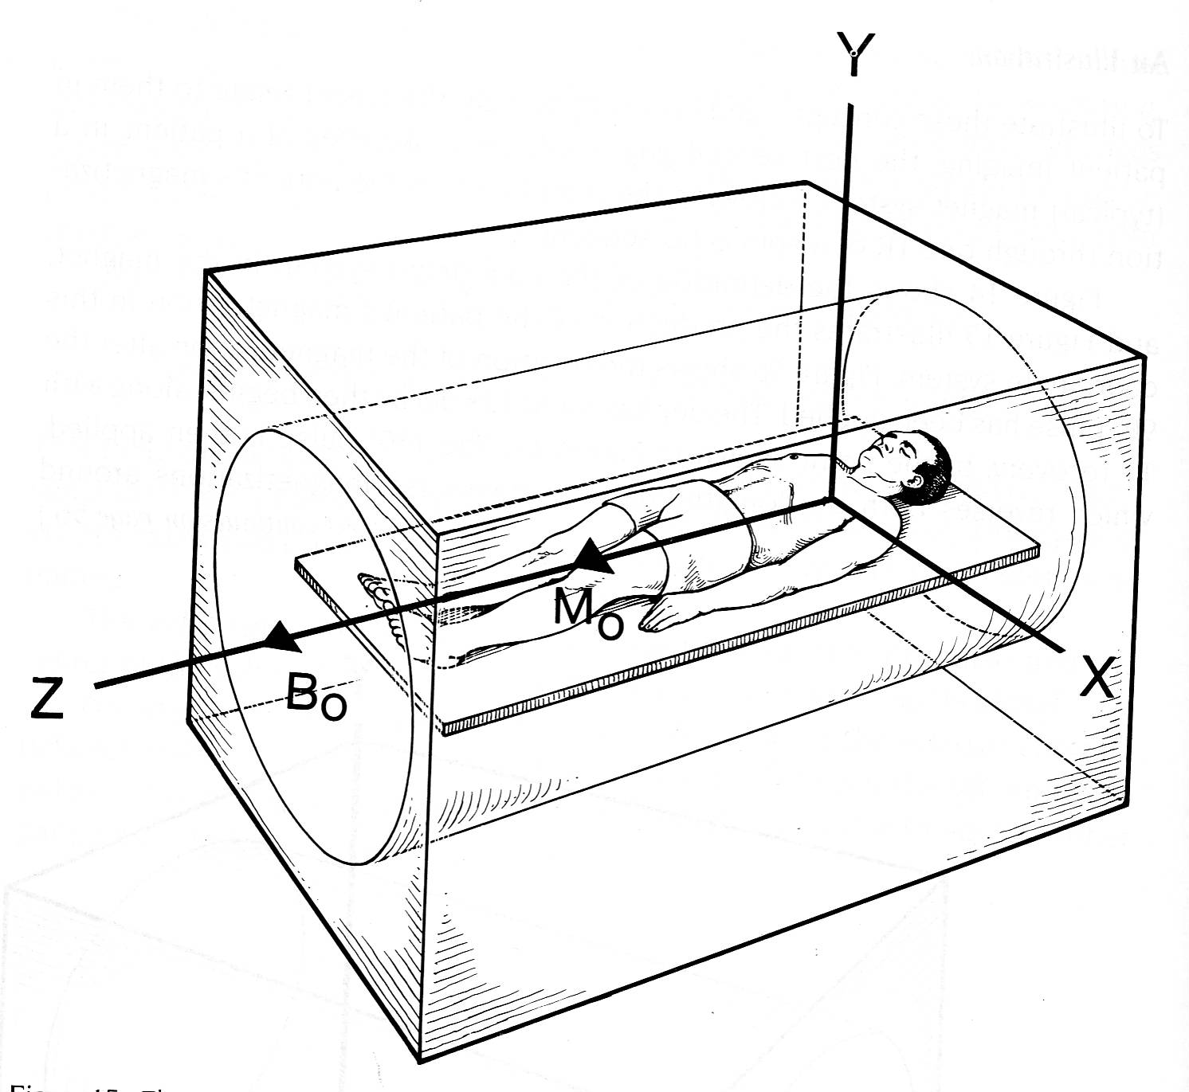
The patient is now inside the bore of the magnet. The net magnetization of the patient’s protons M₀ is aligned and precessing along the Z axis (B₀)
M₀

Slide 11
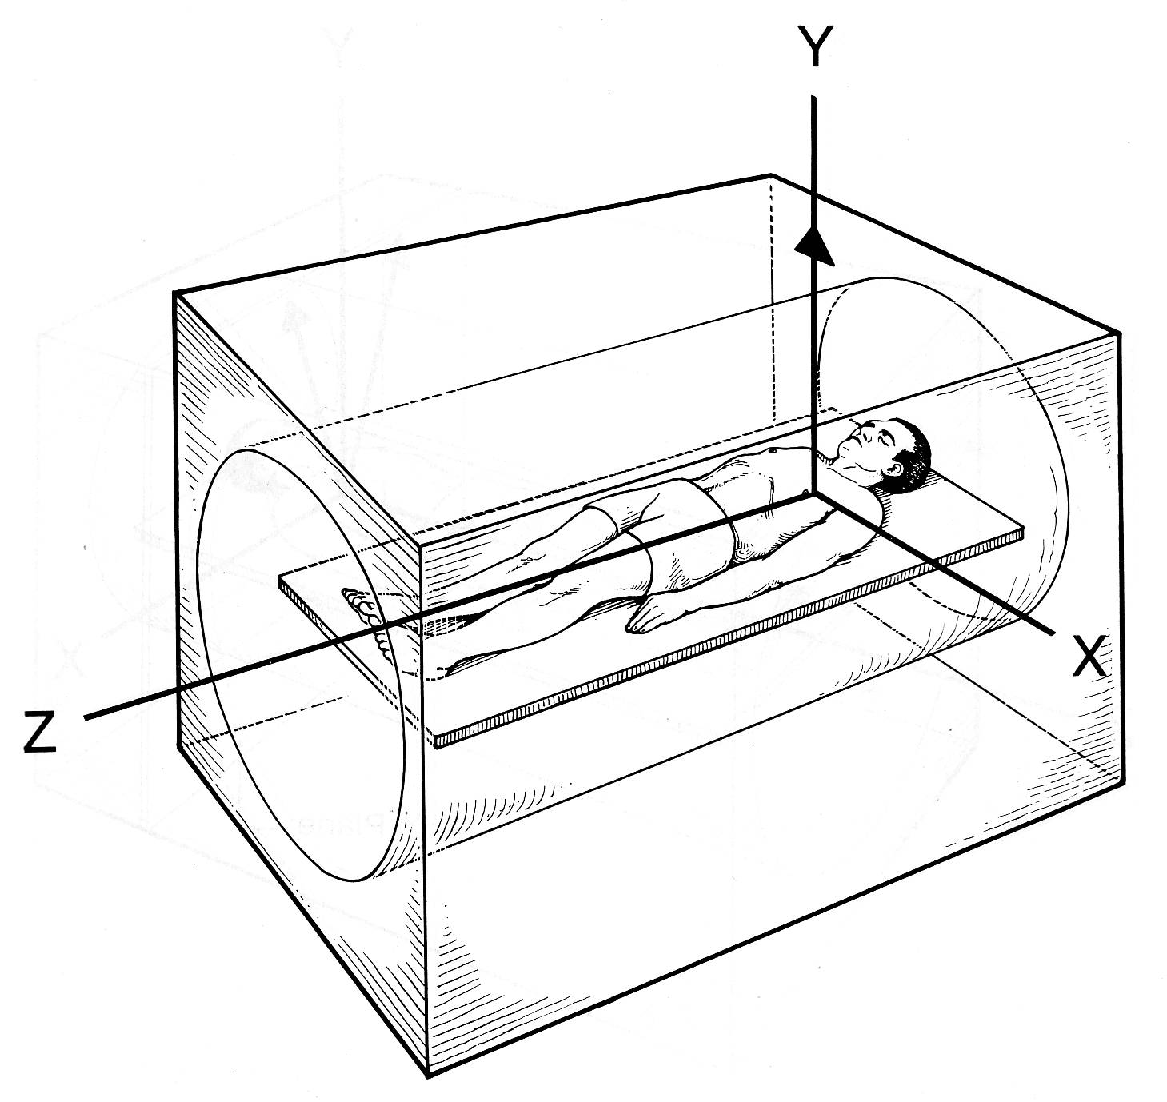
The 90⁰ RF pulse is now applied perpendicular to B₀. Resonance occurs and M₀ is now flipped, and completely removed from the Z axis to lie along the XY plane. It also precess at Larmor frequency.

Slide 12
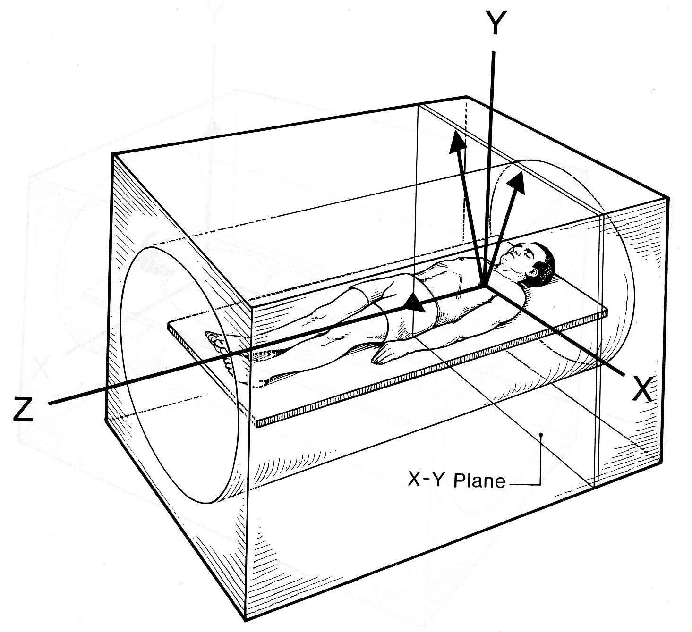
After termination of RF pulse, relaxation is now taking place. Spin-lattice (T1)relaxation caused the magnetization to re-grow along the Z axis. Spin-spin relaxation causes the magnetization vectors to dephase (move apart) while still in the X-Y plane. The magnitude of NMV reduces exponentialy.
Fast
Slow

Slide 13
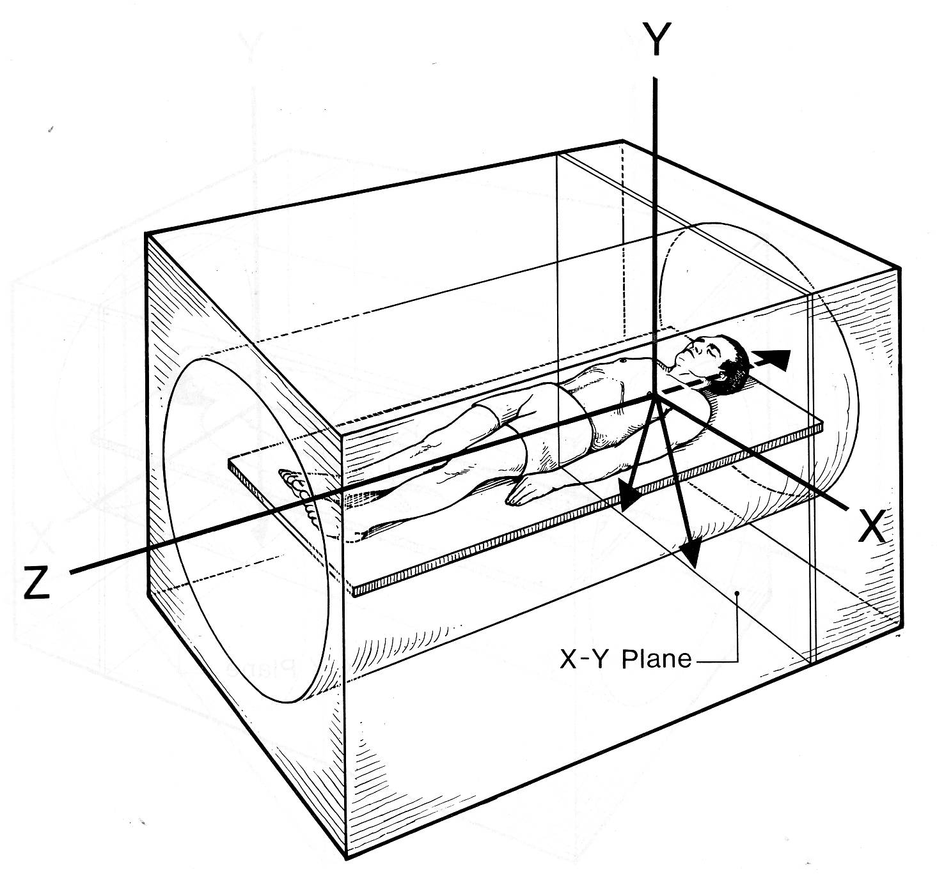
180⁰ pulse is now applied in the XY plane. All the vectors are inverted and now point in the opposite direction. As now the slow nuclei move in front and followed by the fast nuclei the magnetization vectors rephase (come together) in the X-Y plane. As they come together the echo is being formed (i.e NMV is reformed)
Fast
Slow

Slide 14
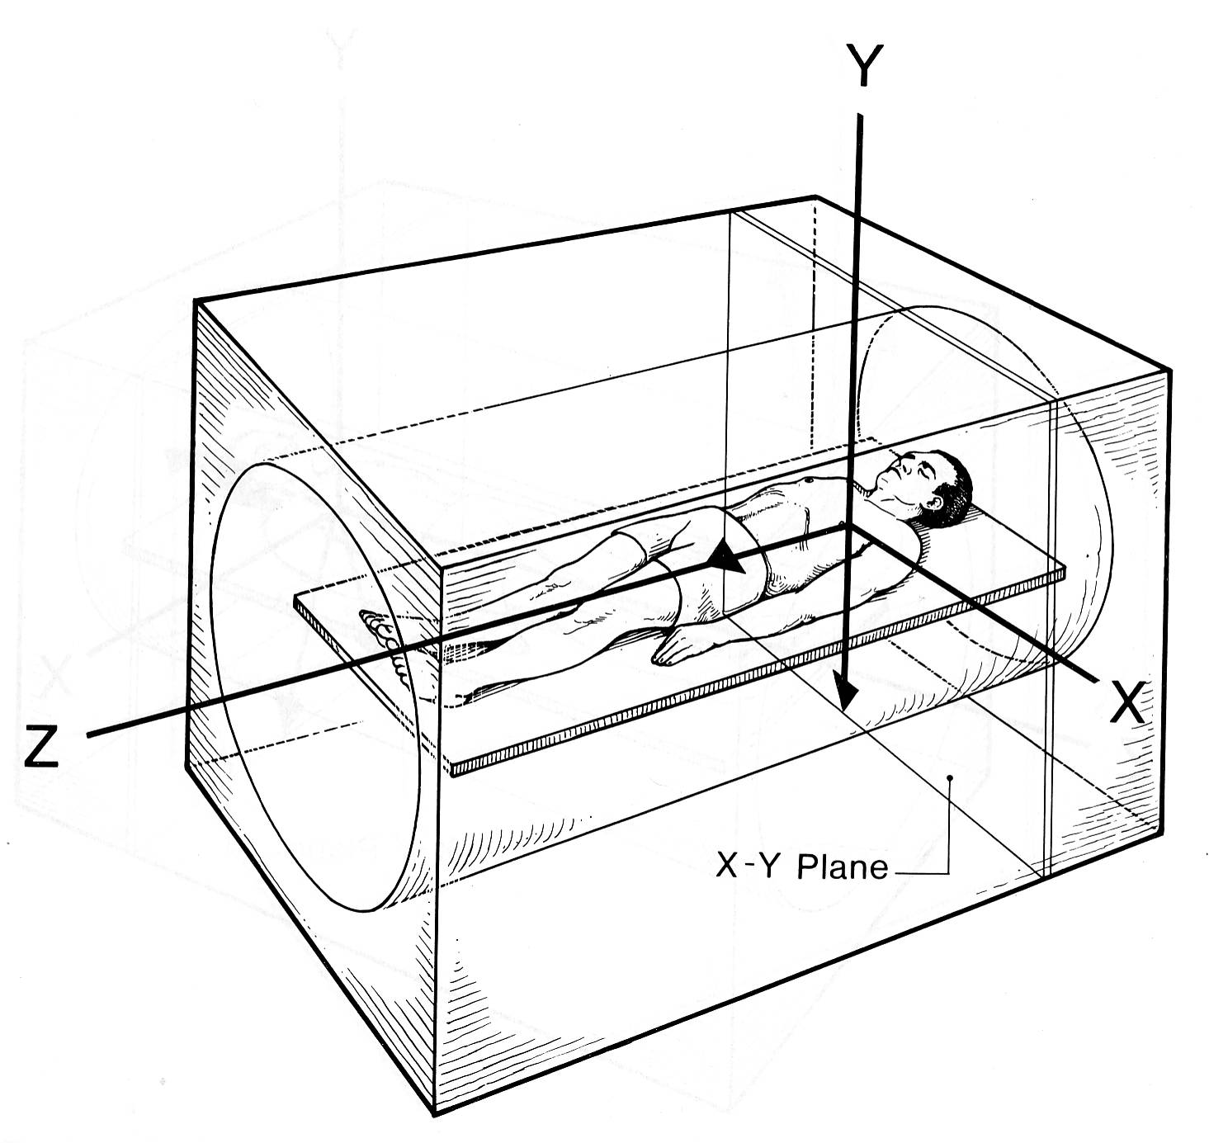
The magnetization is now completely rephased in the X-Y plane. This causes the full height of the echo. The maximum amplitude of MRI signal is collected here.
RF receiver coil

Slide 15
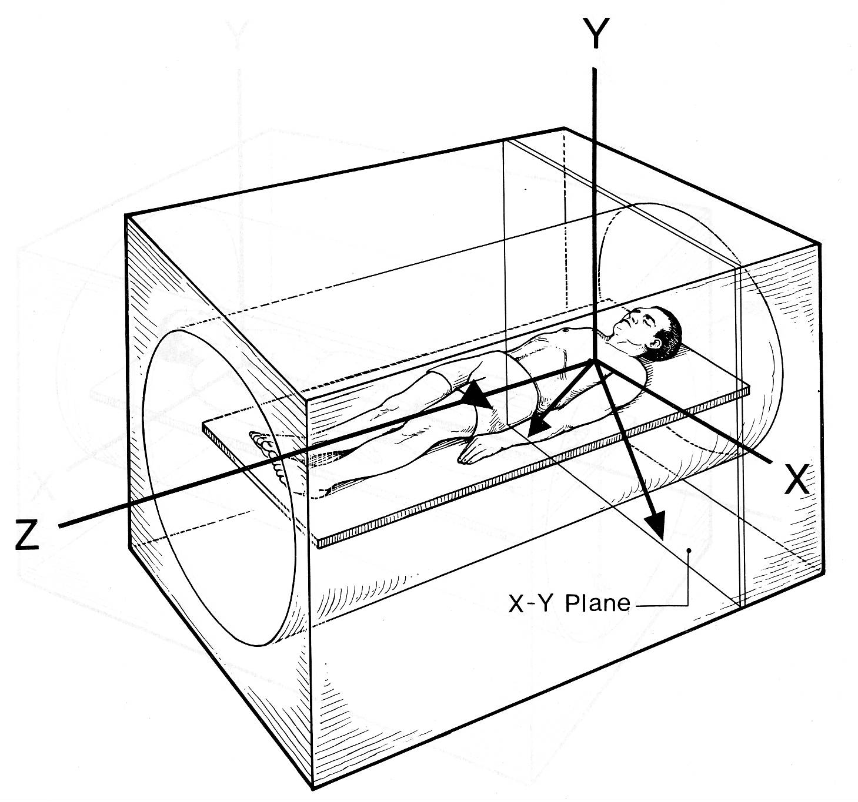
Relaxation continues to take place. The magnetic vectors again dephase in the X-Y plane while the regrowth along the Z axis continues

Slide 16
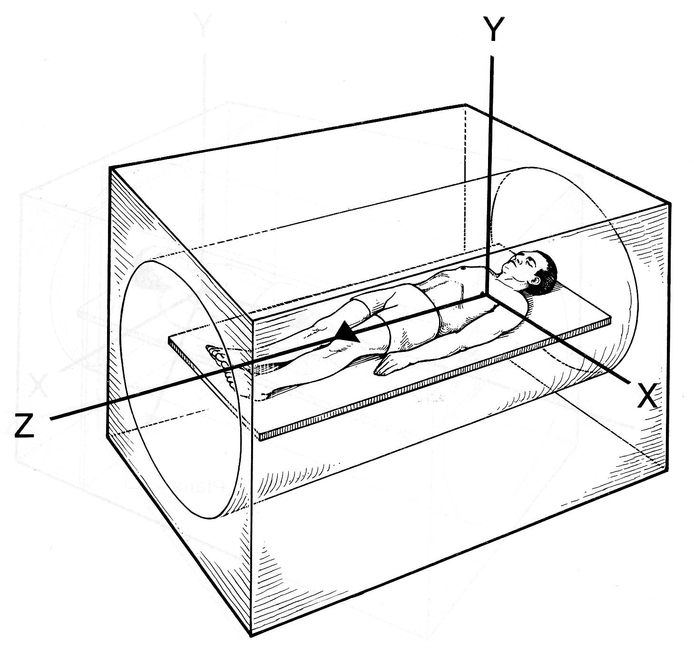
(If allowed) Complete relaxation has taken place. There is no net vector in the X-Y plane, and the magnetization is full grown along the Z axis. This is identical to the situation before the 90⁰ pulse was applied

Slide 17
Relaxation
Mz
fat
T1 Relaxation
muscle
water
M_{z} = M_{z0} ( 1 - exp(-t/T1))
T1: time for M_{z} to recover 63%
Mxy
time
T2 Relaxation
water
M_{xy} = M_{xy0} exp(-t/T2)
fat
muscle
time
T2: time for M_{xy} to decay 37%

Slide 18
Relaxation
T1 and T2 is tissue type dependent
T1 and T2 depends on the magnetic field strength B₀
both increases as B₀ increases
Difference in relaxation times can be used to differentiate tissue types
By changing Pulse sequence parameters

Slide 19
Spin Echo
B₀ - homogeneous
M vectors are in phase
MR Signal
Time
MR Signal decays exponentially as exp(-t/T2*)
B₀ - inhomogeneous
M vectors are not in phase
B₀ - inhomogeneous
MR Signal
Time

Slide 20
Spin Echo
after t = τ
Z
Apply 180⁰ RF pulse (B₁ field) along X
X
after t = τ

Slide 21
Spin Echo
90⁰ RF pulse
τ
180⁰ RF pulse
τ
Spin Echo

Slide 22
180⁰
Spin Echo
90⁰
τ
τ
MR Signal
Time

Slide 23
Short TE and short TR gives T1 weighted image
Use two RF rephasing pulses generating two spin echoes to produce T2 and proton density weighting
First echo has short TE and long TR :produce proton density weighting
Second echo has a long TE and a long TR : produce T2 weighting

Slide 24
Uses
Gold standard for most imaging
May be used for every examination
T1 images useful for demonstrating anatomy better – because high SNR
With contrast enhancement T1 images show pathology
T2 images also demonstrate pathology
Diseased tissues are generally more oedematous and/or vascular.
They have increased water content and, have a high signal on T2 images

Slide 25
Parameters
T1 weighting
Short TE 10-20 ms
Short TR 300 – 700 ms
Typical scan time 4-6 min
Proton density / T2
Short TE 20 ms/long TE 80 ms+
Long TR 2000 ms+
Typical scan time 7-15 min

Slide 26
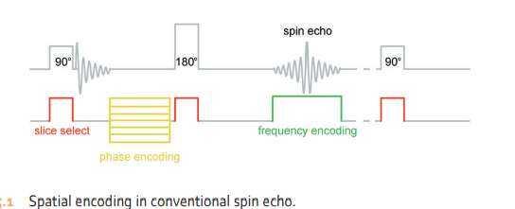
Advantages
Good image quality
Very versatile
What you set is what you get (i.e. the contrast is truly based on the T1 and T2 relaxation times of tissues)
True T2 weighting sensitive to pathology
Disadvantages
Scan times relatively long

Slide 27
Fast Spin Echo / Turbo Spin Echo

Slide 28
Fast / Turbo spin echo
In contrast to conventional spin echo, fast spin echo applies a train of 180⁰ pulses and more than one different phase encoding steps are used per TR.
So, More than one line of K space is filled per TR
Each 180⁰ pulse produces an echo and each fills a line of K space
This drastically reduce the scan time
The number of 180⁰ pulses in the train called the turbo factor or train length

Slide 29
At each 180⁰/phase encoding combination, a different amplitude of phase encoding gradient slope is applied in order to fill out a different line of K space
In conventional spin echo only one line is filled per TR
In fast spin echo several lines corresponding to the turbo factor are filled.
The K space is filled more rapidly and the scan time is reduced.

Slide 30
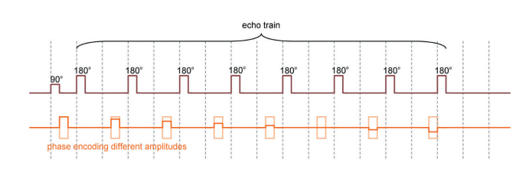
E.g. if in conventional SE 256 phase matrix and 1 NEX is used, the scan time is 256TR
In FSE if the turbo factor is 16, the scan time is 256TR/16 =16TR
The echo train with phase encoding steps of different amplitudes

Slide 31
How is fast spin echo weighted correctly?
The echoes are generated at different TE times and therefore data collected from them has variable weighting.
All these data is stored and placed into one image.
The TE selected is only an effective TE at which the operator wishes to weight the image.
In order to achieve this weighting, the system orders the phase encoding steps so that steep or shallow slopes are applied to the various echoes produced.

Slide 32
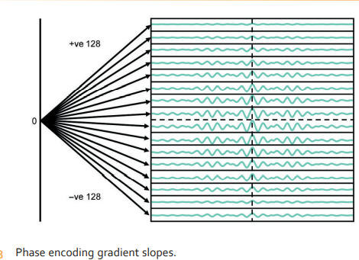
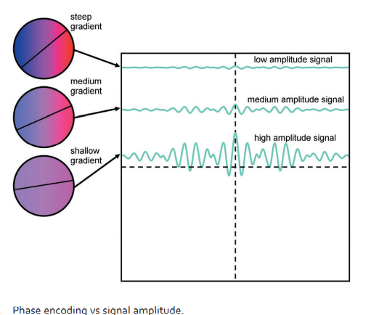
The system orders the phase encodings so that the shallow slopes that produce maximum signal are centered on the effective TE selected
The data from echoes collected around the effective TE has more impact on the image contrast as it fills the central lines of K space which produce the greatest signal amplitude

Slide 33
Phase encoding ordering in fast spin echo
180
90
steep
shallow
Phase encodings
Effective TE
Signal amplitude
Fills the centre lines of K space

Slide 34
K space filling and phase re - ordering

Slide 35
Parameters
These are similar to conventional spin echo.
The turbo factor now plays an important role in image weighting.
The higher the turbo factor, the shorter the scan time, but the resultant image has more of a mixture of weighting because there are more data collected at the wrong TE.
This is not as important in T2 weighted scans, as the proton density data are off set somewhat by the heavily T2 weighted data.
In T1 and proton density weighting, on the other hand, larger turbo factors place too much T2 weighting in the image and hence shorter turbo factors must be used.
The scan time savings in T1 weighted imaging are therefore not as great as with T2 weighting.

Slide 36
Parameters
T1 weighting
Short or minimum effective TE less than 20ms
Short TR 300 – 700 ms
Turbo factor 2-8
Typical scan time 30s to 1 min
Proton density weighting
TR 3000 – 10 000 ms (depending on required slice number)
Effective TE minimum
Turbo factor 2 – 8
T2 weighting
TR 3000 – 10 000 ms (depending on required slice number)
Effective TE 80 – 140 ms
Turbo factor 12 – 30.
Typical scan time 2 min

Slide 37
The TR of fast spin echo is often much longer than that used in conventional spin echo.
The 180 ° RF pulses take time to perform and so fewer slices are available for a given TR.
As the turbo factor increases, the number of slices available per TR decreases, and sometimes the TR has to be significantly increased to achieve the required slice number.
In T1 weighting, increasing the TR reduces the weighting, and so in these circumstances we need to keep the TR short and to perform several acquisitions to obtain coverage of anatomy.
The longer TR associated with fast spin echo somewhat off sets the reduction in scan time achieved, but is far less signifi cant than the huge scan time savings produced by long echo trains.

Slide 38
T1 weighted FSE image

Slide 39
PD weighted FSE image

Slide 40
T2 weighted FSE image
Sagittal T2 weighted fast spin echo sequence through the pelvis.
Note that both fat and water have high signal intensity.

Slide 41
Uses of FSE / TSE
The contrast seen is similar to spin echo, so, Useful in most clinical applications
In Central nervous system, pelvis, musculoskeletal regions, used for T2 weighting
In the chest and abdomen, respiratory artefact is sometimes troublesome if respiratory compensation techniques are not compatible with fast spin echo soft ware. This is off set by the fact that the shorter scan times of fast spin echo enable images to be produced while the patient holds their breath.
Note
Fat remains bright on T2
Unless fat saturation techniques are used
Muscles appear darker in FSE images
Artefacts from metal implants is significantly reduced

Slide 42
Summary
Short turbo factor
decreased effective TE
increased T1 weighting
longer scan time
more slices per TR
reduced image blurring
Long turbo factor
increased effective TE
increased T2 weighting
reduced scan time
reduced slice number per TR
increased image blurring

Slide 43
Advantages & Disadvantages
Advantages
Greatly Reduced scan time
High resolution matrices and multiple NEX can be used
Image quality improved
Increased T2 information
Disadvantages
Some flow and motion effects increased
Incompatible with some imaging options
Fat bright on T2
Image blurring with very long echo trains

Slide 44
Single shot fast spin echo ( SS - FSE )
It is possible to acquire fast spin echo images in even shorter scan times by using a technique known as single shot fast spin echo (SS - FSE) .
In this technique all the lines of K space are acquired in one TR.
SS - FSE combines a partial Fourier technique with fast spin echo.
Half of the lines of K space are acquired in one TR and the other half are transposed.
This technique yields a reduction in imaging time as all the image data are acquired in one TR.
However, there is a SNR penalty.
Currently the highest turbo factor used in single shot imaging is 728.

Slide 45
Another consideration when using long echo trains is that the specific absorption rate ( SAR ) is significantly increased by applying so many successive 180 ° pulses.
This usually manifests itself in a reduction in the number of permissible slices and it can therefore be difficult to get the required coverage in a single acquisition.
It is possible on most systems to reduce the size of the refocusing angle to as low as 120 ° .
This reduces the SAR significantly (which is proportional to the square of the flip angle) but also reduces the SNR.
However, the benefit of being able to obtain more slices per acquisition due to a reduction in SAR may outweigh the decrease in SNR.

Slide 46
Driven equilibrium Fourier transform
In another modification of FSE (which some manufacturers call DRIVE, RESTORE or FR - FSE), a reverse flip angle excitation pulse is applied at the end of the echo train.
This drives any transverse magnetization into the longitudinal plane so that it is available for excitation at the beginning of the next TR period.
Therefore it is not necessary to wait long periods for T1 relaxation to occur.
Some manufacturers rephase the transverse magnetization with a 180 ° pulse before the restoration 90 ° pulse is applied.
As water has the longest T1 and T2 times, most of this magnetization is composed of water and therefore this has a higher signal intensity on the resultant images.
This sequence produces an increase in signal intensity in fluid - based structures such as cerebrospinal fluid (CSF) when using shorter TRs than normal in FSE (Figures on next two slides)

Slide 47
The DRIVE pulse sequence.

Slide 48
Axial DRIVE image through the right internal auditory meatus. Note high signal intensity in CSF.

Slide 49
Inversion Recovery pulse sequence

Slide 50
Introduction
Inversion recovery (IR) was developed in the early days of MRI to provide good T1 contrast on low field systems.
However, the scan times were relatively long and when high field superconducing systems were widely used, this sequence became somewhat redundant.
However, it has re - emerged combined with fast spin echo to produce images in a few minutes.
It is usually used to suppress the signal from certain tissues in conjunction with long TEs and T2 weighting, although at low field it is still used for T1 contrast.
All varieties are discussed here.

Slide 51
Inversion Recovery Pulse mechanism
Starts with a 180⁰ inversion pulse.
This inverts NMV through 180⁰ into full saturation.
When inverting pulse removed NMV begins to relax back to B₀
A 90⁰ excitation pulse is then applied at a time TI (Time from Inversion) from the 180⁰ inversion pulse

Slide 52
After the 90⁰ excitation pulse, the dephasing FID signal is rephased by a 180⁰ rephasing pulse applied at a time TE
This produces the spin echo
TR is the time between each 180⁰ inverting pulse
TI determines the weighting & contrast
Short TI gives T1 contrast
Long TI gives proton density contrast

Slide 53
Inversion recovery pulse sequence

Slide 54
The contrast of the resultant image depends primarily on the length of the TI.
If the 90 ° excitation pulse is applied after the NMV has relaxed back through the transverse plane (short TI), the contrast in the image depends on the amount of longitudinal recovery of each vector (as in spin echo).
The resultant image is heavily T1 weighted because the 180 ° inverting pulse achieves full saturation and ensures a large contrast difference between fat and water (Figure in next two slide).
If the 90 ° excitation pulse is not applied until the NMV has reached full recovery (long TI), a proton density weighted image results, as both fat and water have fully relaxed (Figure in the 3rd and 4th slides below).

Slide 55
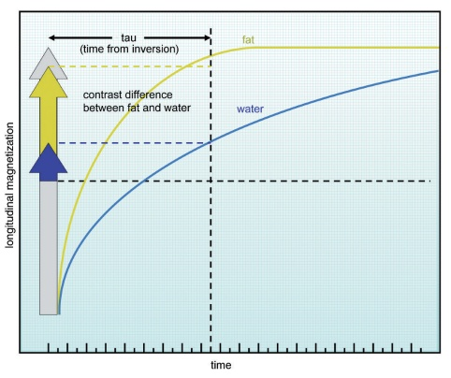
T1 weighting in inversion recovery

Slide 56
Inversion recovery
TI
T1 weighting
Fat
90⁰
180⁰
Creates Contrast difference between fat & water
Water

Slide 57
PD weighting in inversion recovery

Slide 58
Inversion recovery
TI
Proton density weighting
Fat
90⁰
180⁰
No contrast difference between fat & water
Water

Slide 59
Uses
The 180 inversion pulse produces a large contrast difference between fat & water because full saturation of the fat and water vectors is achieved at the beginning of each repetition.
So conventionally used to produce heavily T1 weighted images to demonstrate anatomy (Figure below) & in contrast enhanced imaging
Now more widely used in conjunction with fast spin echo to produce pathology weighted images

Slide 60
Axial T1 weighted inversion recovery sequence through the brain. A TI of 700ms has been used.

Slide 61
Parameters
TE controls the amount of T2 decay
To obtain T1, TE should be short to minimize the T2 effects
TE can be lengthen to produce / give tissues with a long T2 a bright signal
This is called pathology weighting and produces an image predominantly T1 weighted but where pathological process appear bright

Slide 62
TI is the most potent controller of contrast in the inversion recovery
Medium TI values give T1 weighting
If TI is lengthened the image becomes more proton density weighted
TR should always be long enough (longer than 2000 ms) to allow full recovery of NMV before the next inverting pulse is applied
If not, the individual vectors recover to different degrees and the weighting is affected.
As a result the scan times are relatively long (this is rectified by IR fast spin echo)

Slide 63
Typical IR parameters
T1 weighting
Medium TI 400 – 800ms (varies with field strengths)
Short TE 10-20 ms
Long TR 3000ms+
Average scan time 5-15min
Proton density weighting
Long TI 1800 ms
Short TE 10 -20 ms
Long TR 3000ms+
Average scan time 5 – 15 min
Pathology weighting
Medium TI 400-800 ms
Long TE 70 ms+
Long TR 3000 ms+
Average scan time 5-15 miin
Advantages
Very good SNR as TR is long
Excellent T1 contrast
Disadvantages
Long scan times unless combined with fast spin echo

Slide 64
Fast inversion recovery
In this sequence modification the 180 ° inverting pulse is followed after the TI time by the 90 ° excitation pulse and the train of 180 ° RF pulses to fill out multiple lines of K space as in fast spin echo.
This greatly reduces the scan time and enabled a re - emergence of this sequence in clinical imaging.
However, instead of being used to produce T1 weighted images, fast inversion recovery is usually used to suppress signal from certain tissues in conjunction with T2 weighting so that water and pathology return a high signal.
The two main sequences in this category are STIR and FLAIR.

Slide 65
STIR (Short Tau Inversion Recovery)
Uses TI (called Tau) that corresponds to the time it takes fat to recover from full inversion to the transverse plane so that there is no longitudinal magnetization corresponding to fat.
As a result the signal from fat is nulled. So this is called the null point.
So no signal is produced by fat.
Used to achieve suppression of fat in T1 weighted images.
For fat suppression TI 150 – 175 ms (varies slightly with field strengths)
(TI requires to null the signal from tissue is 0.69 times T1 relaxation time)
STIR should not be used in conjunction with contrast enhancement, which shortens the T1 times of enhancing tissues, making them bright. The T1 times of these structures are shortened so that they approach the T1 time of fat. In a STIR sequence therefore, enhancing tissue may also be nulled.

Slide 66
STIR
TI= 0.69x T1 of Fat
Short TI 150-175ms
Short TE 10 – 30 ms
Long TR 2000 ms+
Average scan time 5 – 15 min
Fat
TI
At this point 90 excitation pulse flips fat vector to 180
Can be used in conjunction with fast spin echo. 180 inverting pulse is followed by a 90 excitation pulse after a short TI and then followed by the train of 180 rephasing pulses. It is mainly used with a long turbo factor and long TE to produce T2 weighting with fat suppression so that the appearance of water is enhanced.

Slide 67
Uses of STIR
STIR is an extremely important sequence in musculoskeletal imaging because normal bone, which contains fatty marrow, is suppressed and lesions within bone such as bone bruising and tumors are seen more clearly (Figures next slide ).
It is also a very useful sequence for suppressing fat in general MR imaging

Slide 68
Sagittal STIR sequence of the knee
Sagittal STIR sequence of the lumbar spine using similar parameters
Normal bone marrow has been nulled. Synovial fluid in the joint has a high signal as the TE is long and the image is therefore T2 weighted

Slide 69
Parameters
Short TI (tau) 150 – 175 ms (to suppress fat depending on field strength)
Long TE 50 ms + (to enhance signal from pathology)
Long TR 4000 ms + (to allow full recovery)
Long turbo factor 16 – 20 (to enhance signal from pathology)
Average scan time 5 – 15 min

Slide 70
FLAIR ( fluid attenuated inversion recovery)

Slide 71
FLAIR (Fluid attenuated inversion Recovery)
The signal from CSF (fluid) is nulled by selecting a TI corresponding to the time of recovery of CSF from 180⁰ to the transverse plane and there is no longitudinal magnetization present in CSF.
When the 90⁰ excitation pulse is applied, the CSF vector is flipped through 90⁰ into full saturation again.
Used to suppress high signal from CSF in T2 and proton density weighted images so that pathology adjacent to the CSF is seen more clearly
Parameters
TI - 1700 -2200 ms,
Short or long TE depending on weighting required
long TR 6000 ms+,
Average scan time 13-20 mins

Slide 72
Fluid Attenuated Inversion recovery
TI
TI =0.69 x T2 of water
Fat
180⁰
Water
There is no longitudinal component of Water when the 90 degrees pulse is applied, so there is no transverse component and the signal is nulled

Slide 73
Uses
FLAIR is used in brain and spine imaging to see periventricular and cord lesions more clearly, because high signal from CSF that lies adjacent is nulled.
It is especially useful in visualizing multiple sclerosis plaques, acute sub - arachnoid hemorrhage and meningitis (Figure next slide).
Sometimes gadolinium is given to enhance pathology.
This oddity (gadolinium enhancement in T2 weighted images) may be due to the fact that the long echo trains used in FLAIR sequences cause fat to remain bright on T2 weighted images.
As gadolinium reduces the T1 relaxation time of enhancing tissue so that it is similar to fat, enhancing tissue may appear brighter than when gadolinium is not given.

Slide 74
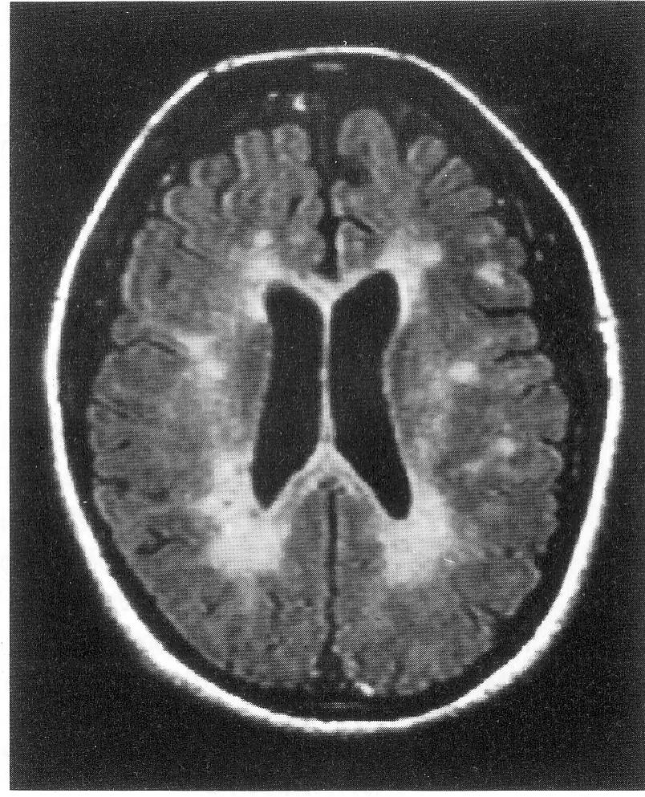
Flair image of brain
T2 weighted fast FLAIR image
TI 1750ms
TE 140 ms
TR 4600 ms

Slide 75
Axial FLAIR image through the brain

Slide 76
Another modification of this sequence in brain imaging is selecting a TI time that corresponds to the null point of white matter.
This nulls the signal from normal white matter so that lesions within it appear much brighter by comparison.
This sequence (which requires a TI of about 300 ms) is very useful for white matter lesions such as periventricular leukomalacia and for congenital gray/white matter abnormalities (Figure below )

Slide 77
Coronal IR sequence using a TI that nulls white matter

Slide 78
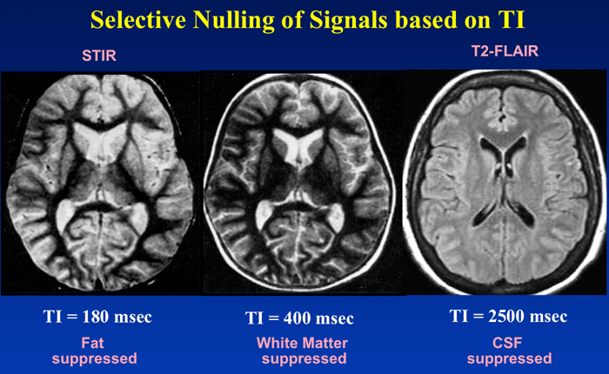

Slide 79
Parameters
long TI 1700 – 2200 ms (to suppress CSF depending on field strength)
long TE 70 ms + (to enhance signal from pathology)
long TR 6000 ms + (to allow full recovery)
long turbo factor 16 – 20 (to enhance signal from pathology)
average scan time 13 – 20 min

Slide 80
IR prep sequences
There are two further modifications of fast IR that were specifically developed to null blood in cardiac imaging .
Double IR prep begins with two 180 ° pulses.
One is non - slice selective and inverts all spins in the imaging volume, and the other is slice selective and re - inverts spins within a slice.
A TI corresponding to the null point of blood (about 800 ms) completely nulls the signal from blood in the slice so that black blood imaging results.
This is useful when looking at the morphology of the heart and great vessels.
Triple IR prep adds a further inverting pulse at the TI of fat (about 150 ms) to null fat and blood together.
This is useful when determining fatty infiltration of the heart walls ( see Figure in next slide ).
(This will be discussed in Flow phenomena)

Slide 81
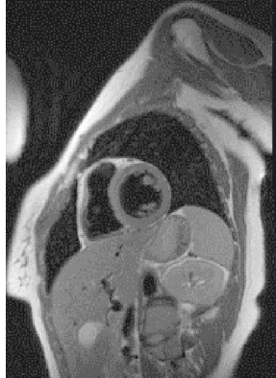
This image has been acquired with a double IR prep sequence.
This imaging plane demonstrates a short axis view of the heart.
Since the heart is oriented ‘ obliquely ’ within the chest cavity, a double oblique acquisition is required to enable the visualization of an axial view of the heart itself

Slide 82
Next – Gradient echo pulse sequences
End of lesson

