Slide 1
Introduction to Magnetic Resonance Imaging
V.G.Wimalasena
Principal
Sri Lanka School of Radiography

Slide 2
What is MRI?
Magnetic Resonance Imaging (MRI), or Nuclear Magnetic Resonance Imaging (NMRI), is a Medical Imaging technique most commonly used in present health care systems to visualize the structure and function of the body.
It provides detailed high contrast images of the body tissues in any plane.

Slide 3
Timeline of MR Imaging
1972 – Damadian patents idea for large NMR scanner to detect malignant tissue.
1985 – Insurance reimbursements for MRI exams begin.
1973 – Lauterbur publishes method for generating images using NMR gradients.
MRI scanners become clinically prevalent.
1924 - Pauli suggests that nuclear particles may have angular momentum (spin).
1937 – Rabi measures magnetic moment of nucleus. Coins “magnetic resonance”.
NMR renamed MRI
1920
1930
1940
1950
1960
1970
1980
1990
2000
1946 – Purcell shows that matter absorbs energy at a resonant frequency.
1973 – Mansfield independently publishes gradient approach to MR.
1990 – Ogawa and colleagues create functional images using endogenous, blood-oxygenation contrast.
1959 – Singer measures blood flow using NMR (in mice).
1946 – Bloch demonstrates that nuclear precession can be measured in detector coils.
1975 – Ernst develops 2D-Fourier transform for MR.
Important developments related to MRI from 1920 to 2000

Slide 4
History
MRI is a relatively new technology, which has been in use for little more than 40 years (compared with over 120 years for X Ray Imaging (Radiography).
In 1969 Raymond Damadian prposed NMR
could be used for medical diagnosis.
In 1973 Paul Lauterbur showed NMR could
produce images
first MR Image was published in 1973 /1974
First whole-body MRI built in 1977and the first study performed on a human took place on July 3, 1977

Slide 5
Basic Principle
Magnetic resonance imaging was developed from knowledge gained in the study of Nuclear Magnetic Resonance.
Uses high intensity magnetic field to keep the patient in
Based on the behavior (alignment) of hydrogen nuclei in a magnetic field
Radiofrequency fields are used to systematically alter the alignment of the nuclear magnetization of Hydrogen nuclei, causing the hydrogen nuclei to produce a rotating magnetic field detectable by the scanner.
The signal detected can be manipulated by additional magnetic fields to build up enough information to construct an image of the body.

Slide 6
Advantages
Best method of demonstrating Anatomy
High tissue differentiation (contrast)
No radiation risk
Direct acquisition of images in any plane

Slide 7
MRI Vs CT
MRI provides much greater contrast between the different soft tissues of the body than CT does, making it especially useful in neurological (brain), musculoskeletal, cardiovascular, and oncological (cancer) imaging.
Unlike CT, it uses no ionizing radiation, but uses a powerful magnetic field to align the nuclear magnetization of (usually) hydrogen atoms in water in the body.

Slide 8
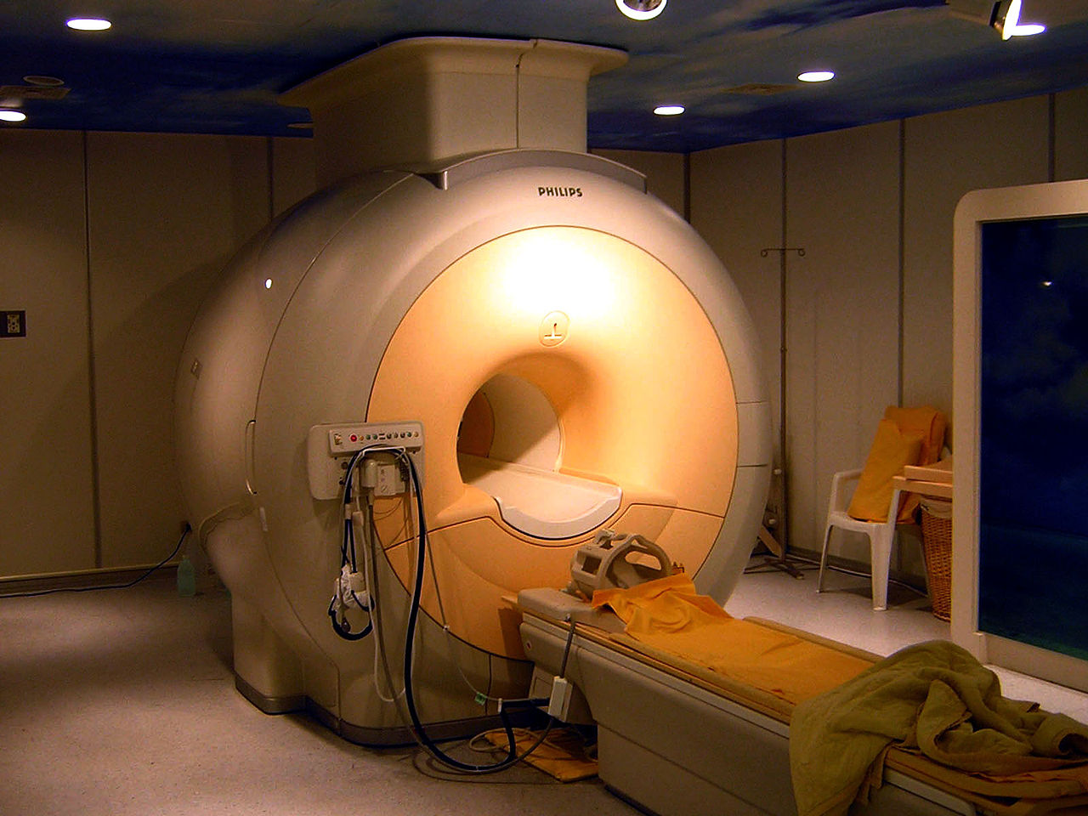
Modern MRI unit

Slide 9
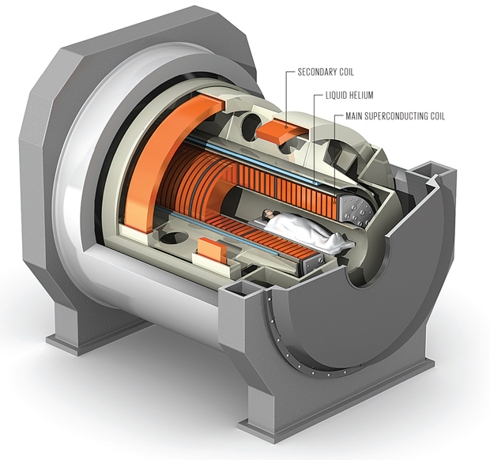
Model MRI showing internal structure

Slide 10
System components
Gradient amplifiers
Magnet power supply
Shim power supply
RF transmitter
Operator consol
Magnet coils
Shim coils
Gradient coils
Host computer
RF coils
Magnet bore
Image processor
Image disk
RF receiver
Digitizer

Slide 11
Basic MRI Physics
MRI uses the phenomenon of the behavior of some atomic nuclei in a magnetic field.
Basic element used is Hydrogen
The hydrogen nucleus behaves as a small magnet in an external magnetic field.
This property is explored in MRI

Slide 12
Atomic structur & Types of atomic motion
The electron orbits the nucleus
The electron spins on its own axis
***The nucleus spins on its own axis***

Slide 13
Properties of Hydrogen atom
1 electron orbits the nucleus
The nucleus contains 1 proton but no neutrons
So the hydrogen nucleus has a net positive
charge
Hydrogen nucleus is a spinning, positively
charged particle

Slide 14
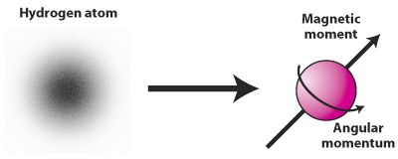
A charged particle in motion will create a magnetic
field
The postitively charged, spinning hydrogen nucleus
generates a magnetic field
https://youtu.be/ASuK9fG6wEU

Slide 15
According to Law of electromagnetism
A charged particle in motion will create a
magnetic field
The positively charged, spinning hydrogen
nucleus generates a magnetic field and said to
produce a magnetic moment
When hydrogen nucleus is placed in an external
magnetic field it will align with that field
So hydrogen is said to be MR active.

Slide 16
MR Active Nuclei
The nuclei which has a magnetic moment and
tendency to align its axis of rotation to an applied
magnetic field.
Have odd number of protons or odd number of
neutrons
e.g. Hydrogen¹, Carbon¹³, Nitrogen¹⁵, Oxygen¹⁷, Fluorine¹⁹, Sodium²³, Phosphorus³¹

Slide 17
Why HYDROGEN selected in MRI?
Very abundant in the human body as H₂0 and
combined with the other atoms
Has a large magnetic moment

Slide 19
When a body is placed into the bore of the scanner, the strong magnetic field will cause the individual hydrogen nuclei to either:
A) Align anti-parallel to the main magnetic field (B₀)
OR
B) Align parallel to the main magnetic field (B₀)
Anti-parallel
high energy
B₀
NMV
Parallel
low
energy

Slide 20
Net Magnetization Vector
There are nuclei precessing parallel or antiparallel to the Main magnetic field (B₀).
Number of nuclei precess parallel are more than the nuclei precess antiparallel.
So if we take the algibric sum there is a net number of nuclei pressing parallel to B₀
So the sum of the individual magnetic moments precessing parallel is called the Net Magnetic Vector (NMV).

Slide 21
Net Magnetization Vector (NMV)
An excess of hydrogen nuclei will line up parallel to B₀ and add up to create the NMV of the patient
It has a Magnitude and a direction
So it is a vector quantity
It is therefore named NMV

Slide 22
N
N
S
S
size
direction
The magnetic
vector

Slide 23
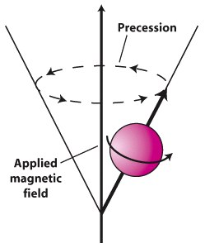
The nuclei and therefore the NMV will also precess around the Main Magnetic field

Slide 24
Precession
Due to the influence of B₀, the hydrogen nucleus “wobbles” or precesses (like a spinning top as it comes to rest under gravity)
The axis of the nucleus forms a path around B₀ known as the “precessional path”
Precessional
path
B₀
Hydrogen
nucleus

Slide 25
Precessional Frequency
The speed at which hydrogen precesses depends on the strength of B₀ and is termed the “precessional frequency”
The precessional frequency of hydrogen in a 1.5 Tesla magnetic field is 63.86 MHz
The precessional positions of the individual hydrogen nuclei are random, or “out of phase”
1
2
3
Three nuclei are at different places on the precessional path

Slide 26
Detecting the precessing protons
In order to make use of the precession of hydrogen nuclei (protons) and the NMV, we have to detect them.
To do that we have to change their alignment away from the magnetic field.
It need them to be “in-phase” too.
It is the next step done by applying a Radiofrequency(RF) pulse to make the nuclei resonate with it.

Slide 27
RESONANCE
Is the phenomenon that occurs when an oscillating object is exposed to an oscillating perturbation that has a frequency close to its own natural frequency of oscillation

Slide 28
RESONANCE cont…d
Frequency of the hydrogen proton in a 1.5T magnetic field (63.86 MHz) can be found in the RF band of energy in the electromagnetic spectrum.
So a burst (pulse) of RF energy at 63.86 MHz is applied to the selected area.
The precessing protons (nuclei) absorb the energy and resonates.

Slide 29
Radiofrequency pulse
According to the Law of Electromagnetism charged particles in motion will generate a magnetic field.
The Magnetic field of RF is taken as B₁
It is Applied as a “pulse” during MR sequences
The RF pulse is applied so that B₁ is 90° to B₀

Slide 30
Result of Resonance…
1) The hydrogen nuclei begin to precess “in phase”1)
Pressing
path
nuclei
The hydrogen nuclei tries to align with the RF’s magnetic field(B₁) and they flip. So the NMV flips.
RF
B₀
B₀
NMV flips
NMV
PULSE
B₁
B₁

Slide 31
As the nuclei precess in-phase in the B₁
plane, a changing magnetic field is
created
If you place a receiver coil (antenna) in
the path of the changing magnetic field, a
current will be induced
This is Faraday’s law of induction

Slide 32
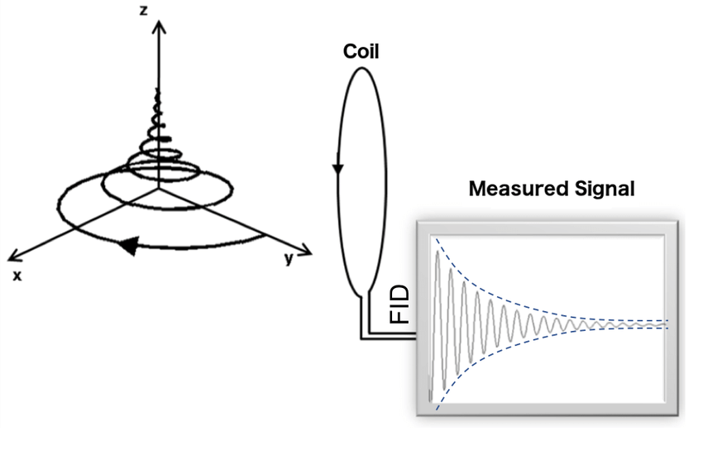
Detecting MR signal

Slide 33
Faraday’s laws of Induction
A changing magnetic field will induce an
electrical current in any conducting medium (coil)
passing an alternating current through a conductor
(coil) can produce electromagnetic radiation
So COILS are
Used to:
Transmit pulses of radiofrequency energy
Induce voltage - MR SIGNAL
Increase image quality by tuning in to one body
part at a time

Slide 34
RELAXATION
When the RF pulse is turned “off”, the NMV “relaxes” back to B₀ (away from B₁)
NMV
B₀
B₁
RF pulses are applied very quickly in succession – RF
PULSE SEQUENCE
E.g. 3 minute sequence (20 slices, axial brain) - 60 RF
pulses may be applied

Slide 35
MR SIGNAL
It is Encoded through a series of complex techniques during acquisition
Collected by a coil
Stored as data
Then decoded through complex calculations
Mapped onto an image matrix

Slide 36
TR - Repetition time
Time from the application of one RF pulse to another RF pulse
TE - Echo time
Time from the application of the RF pulse to the peak of the signal induced in the coil

Slide 37
T1 Weighting
A short TR and short TE will result in a T1
weighted image
Excellent for demonstrating anatomy
T2 Weighting
A long TR and long TE will result in a T2
weighted image
Excellent for demonstrating pathology
Many other different types of images that combine above and include other parameters

Slide 38
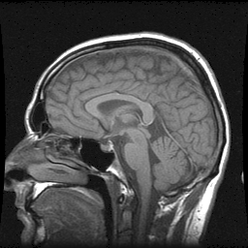
T1 Weighted Sagittal normal brain image

Slide 39
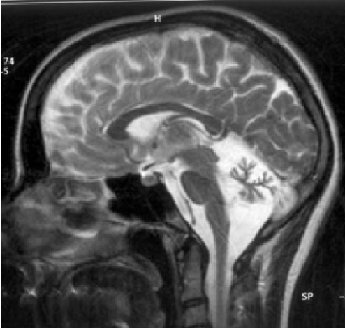
T2 weighted sagittal Brain

Slide 40
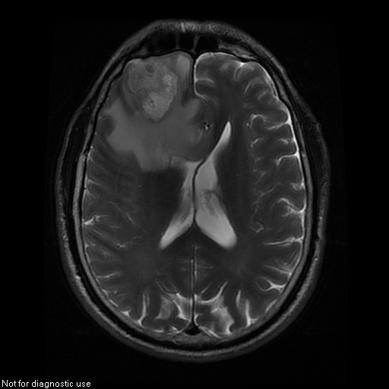
T2 Weighted axial Image showing pathology

Slide 41
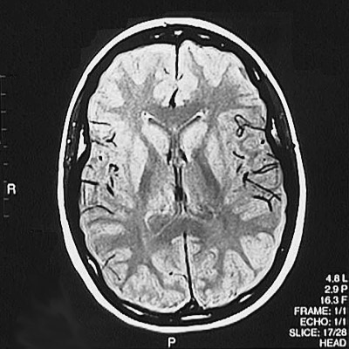
Proton Density weighted image

Slide 42
End of Introduction part 1

